Slide 1
Machine Learning
Raghu Prasad K S

Slide 2
Introduction
Raghu Prasad – BE, MS
Total of 23 years of experience
7 years as a lecturer in Engineering College
16 Years into IT
Worked with companies like CISCO,CSC,ICICI,First Apex – NTT Data
Currently into Corporate training and consultancy
Worked with corporates and public sector
Technologies – Java,Python,Web technologies,Java Script technologies (MEAN stack),IOT,Test Automation – Selenium,JMeter

Slide 3
Course Outline
Introduction to Machine Learning
AI vs ML Vs DL
Machine learning examples
Types of Machine Learning
Machine Learning Algorithms

Slide 4
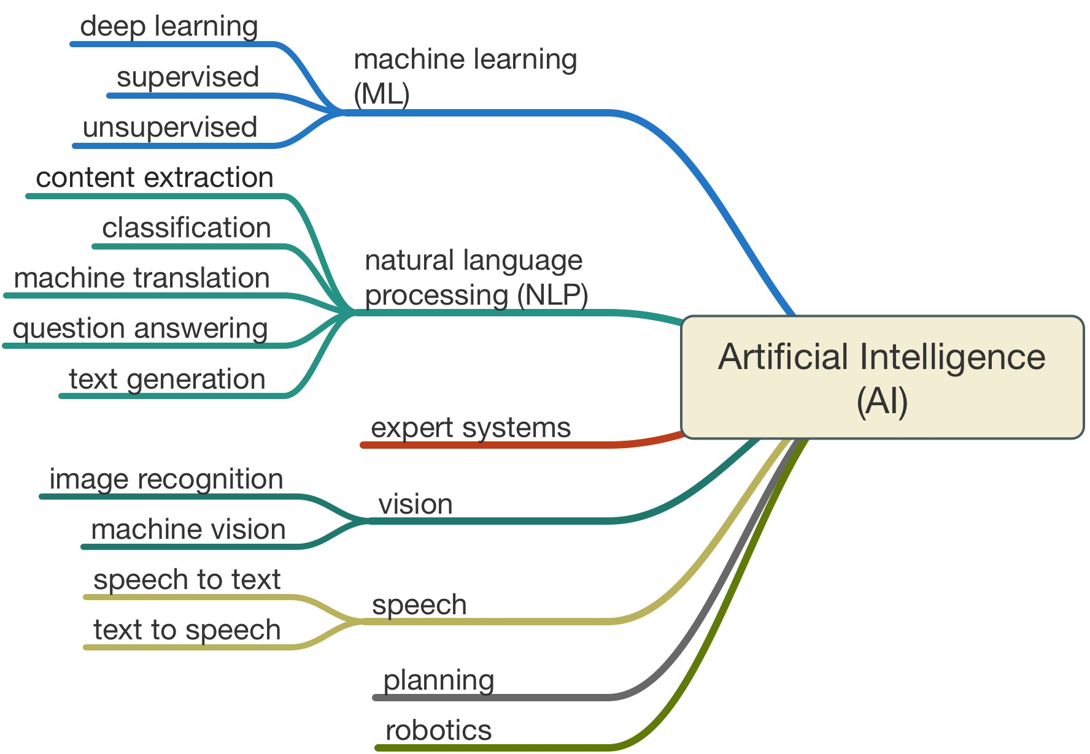
Introduction

Slide 5
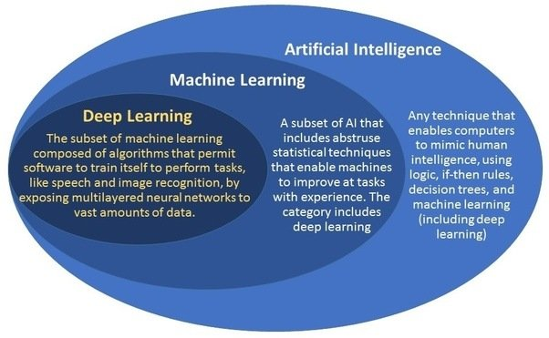
Introduction

Slide 6
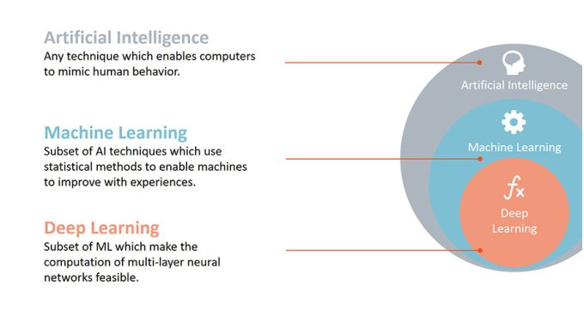
Introduction

Slide 7
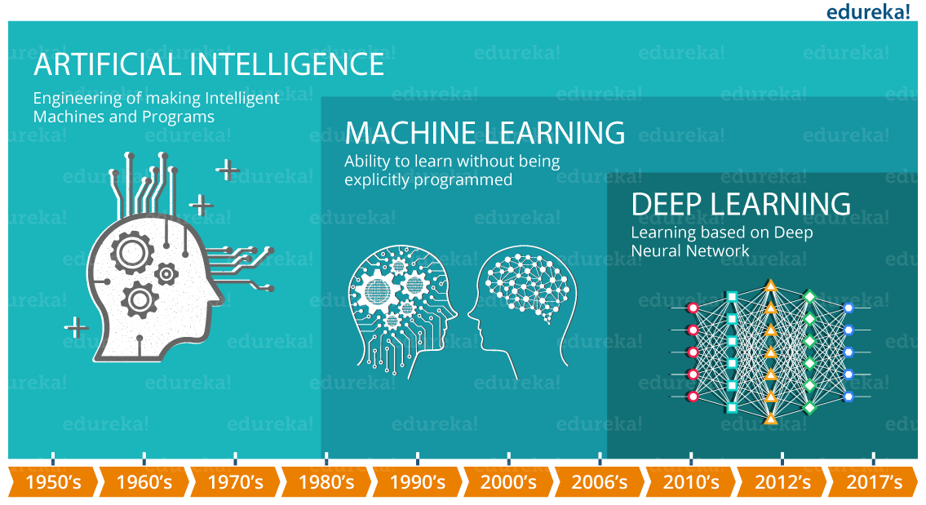
Introduction

Slide 8

AI Examples – Chess playing machine

Slide 9
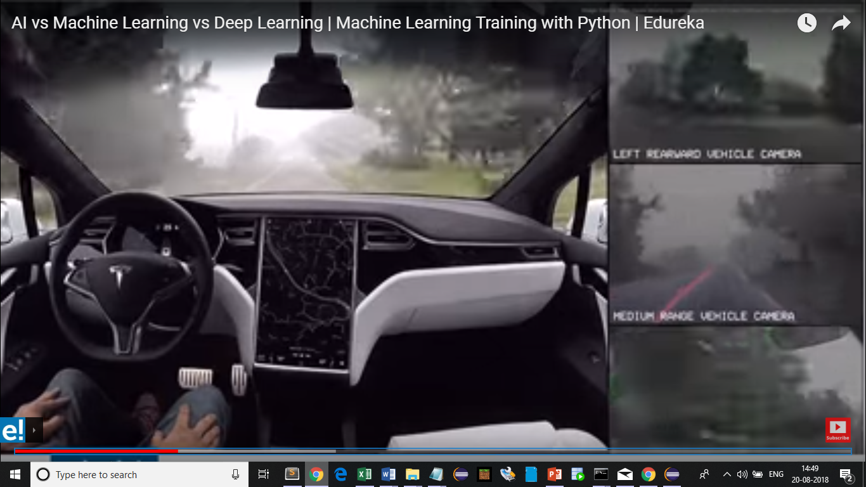
AI Examples – Tesla self driven car

Slide 10
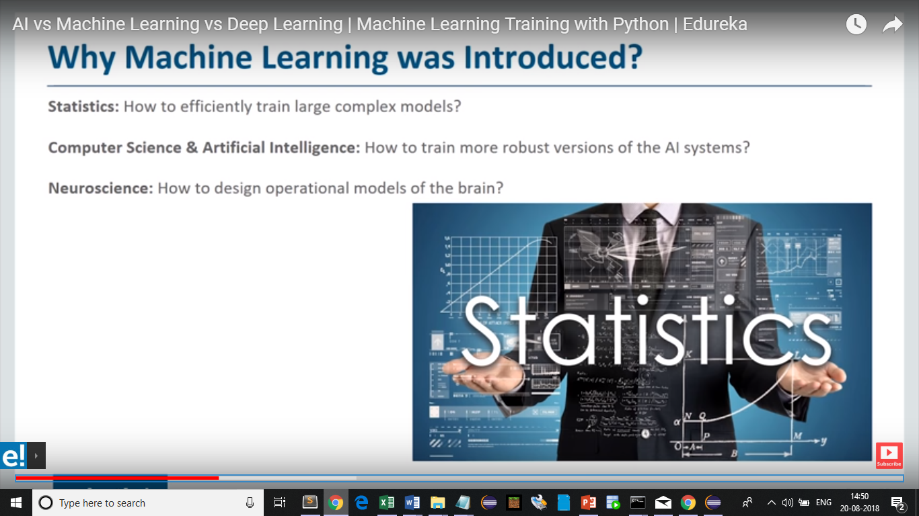
Why machine learning

Slide 11
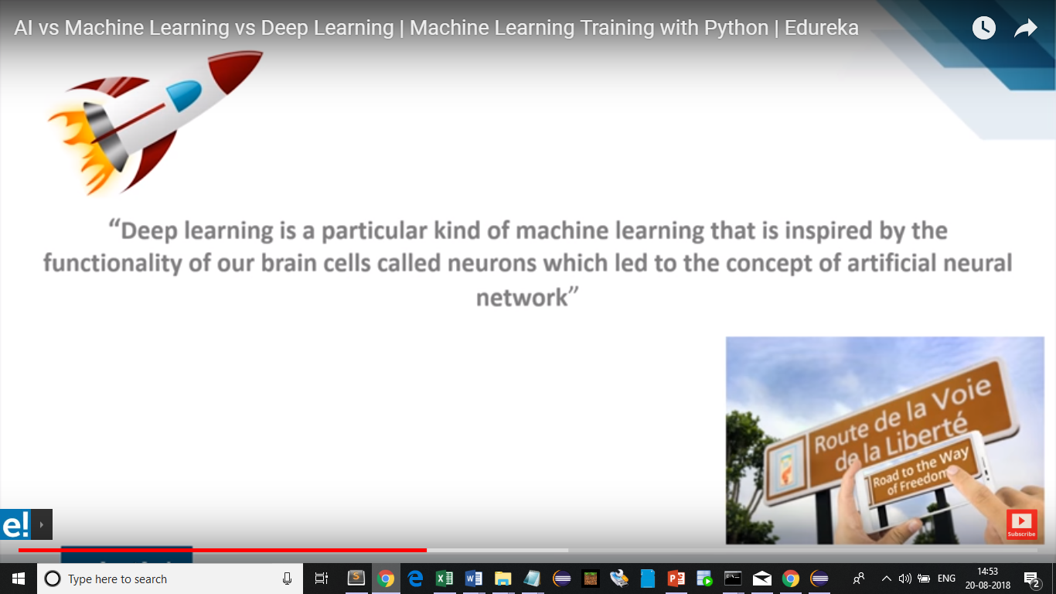
Deep learning

Slide 12
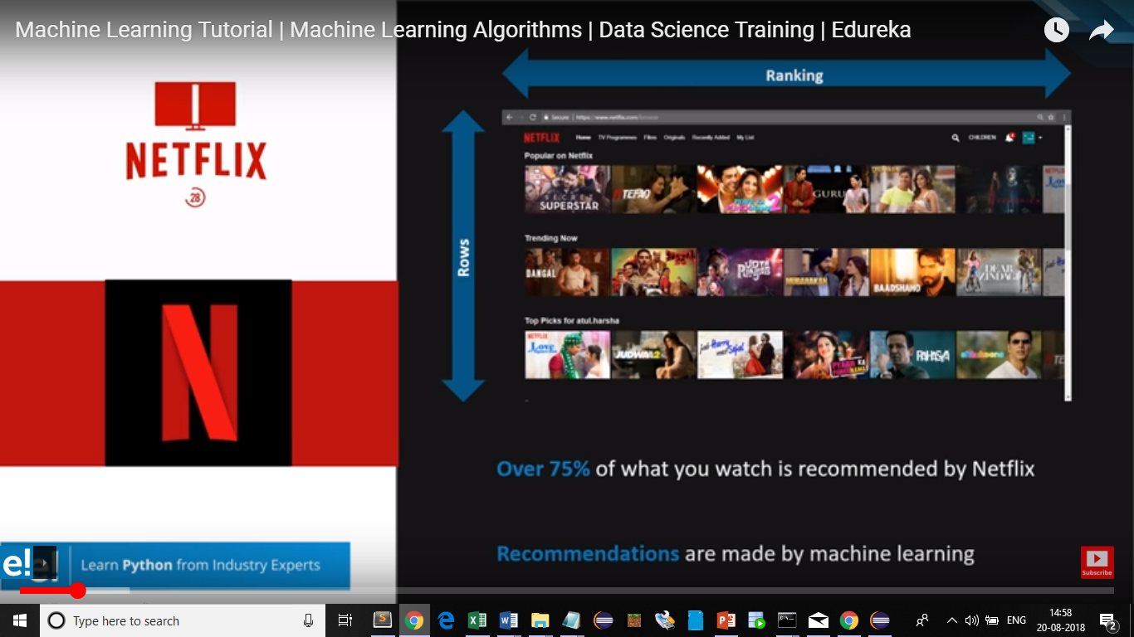
Machine Learning - Netflix

Slide 13

Machine Learning - Facebox

Slide 14
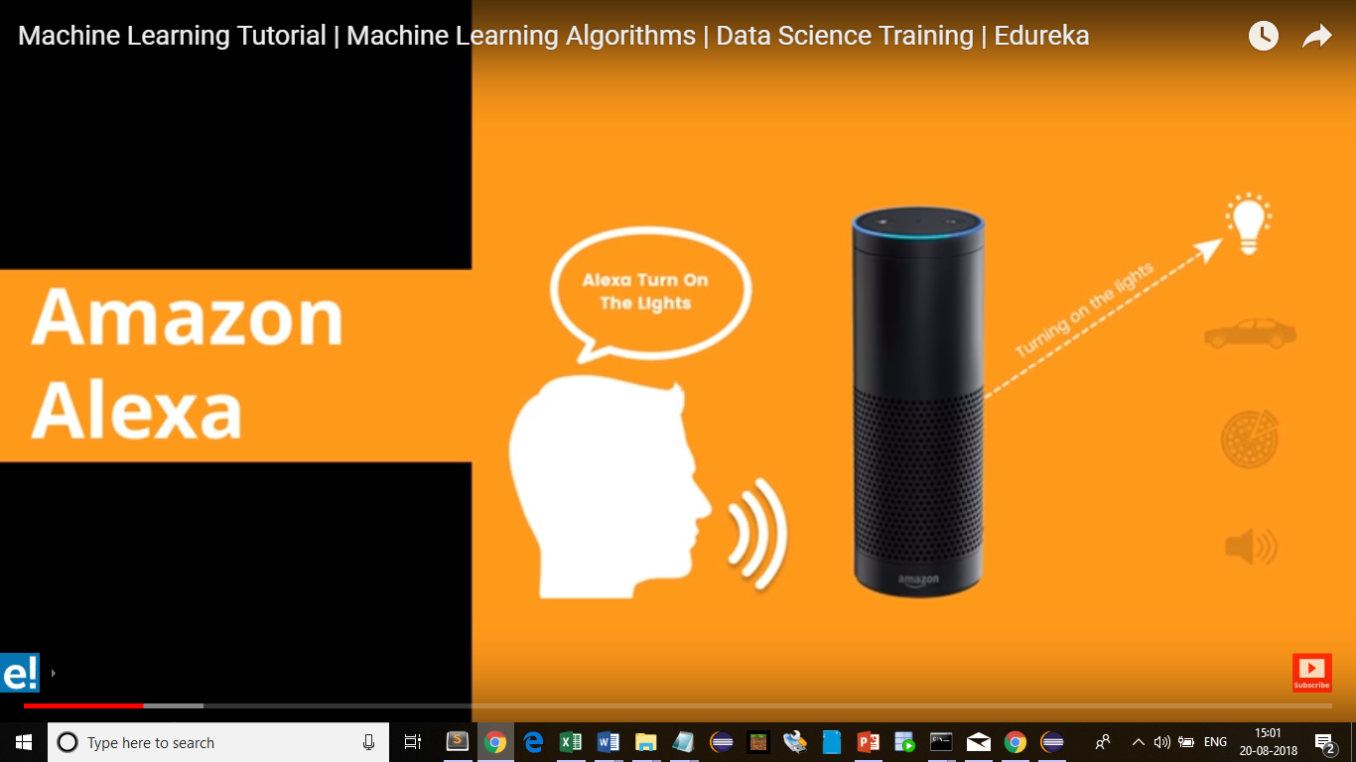
Machine Learning – Amazon Alexa

Slide 15

Machine Learning – Gmail –Spam filtering

Slide 16
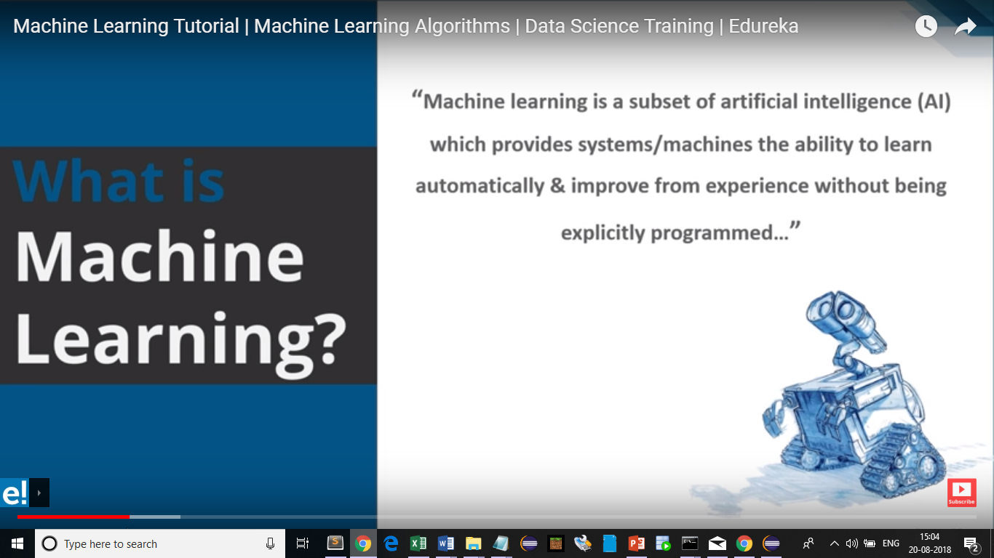
What is Machine Learning ?

Slide 17
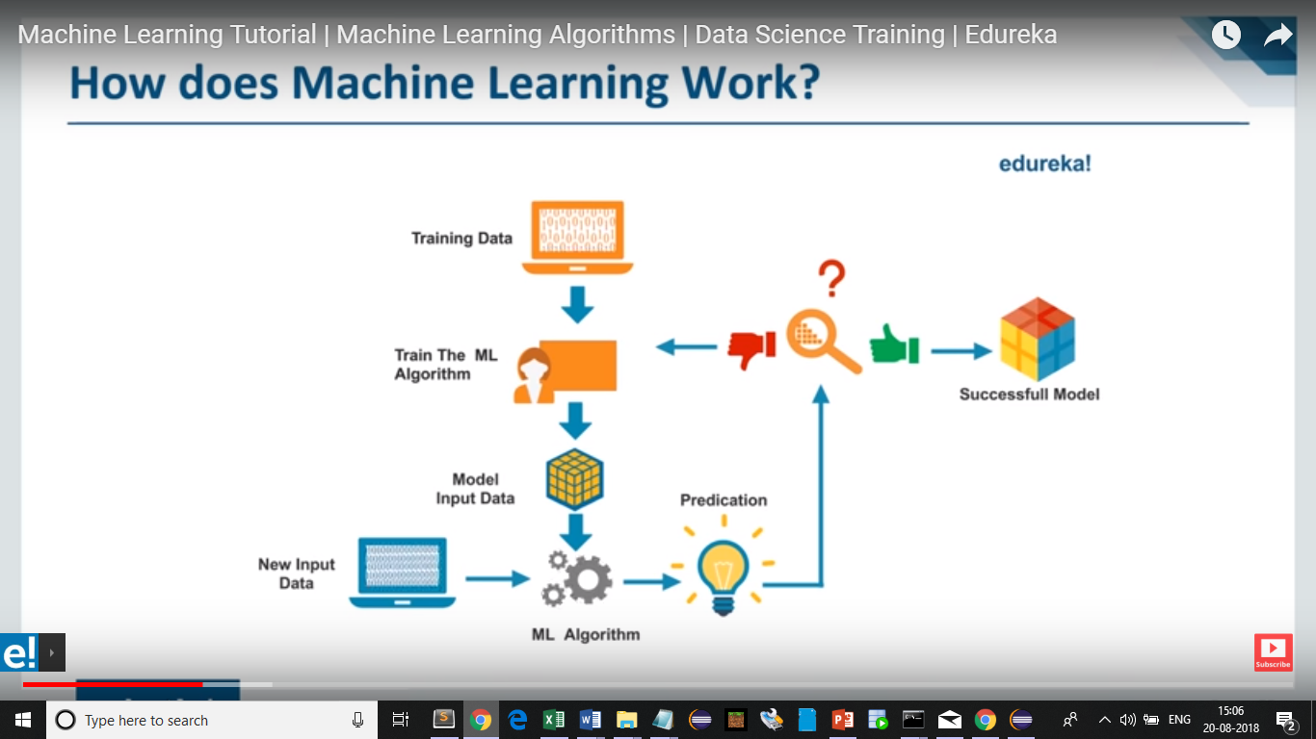
How does machine learning works ?

Slide 18
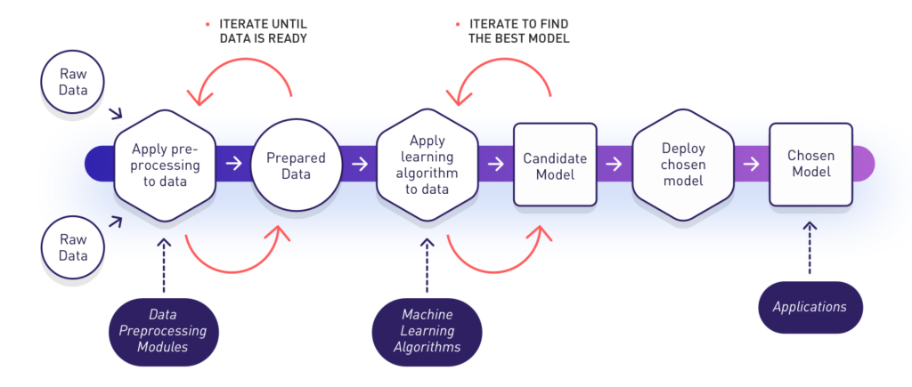
Introduction

Slide 19
Types of machine learning
1. Supervised Learning
How it works: This algorithm consist of a target / outcome variable (or dependent variable) which is to be predicted from a given set of predictors (independent variables). Using these set of variables, we generate a function that map inputs to desired outputs. The training process continues until the model achieves a desired level of accuracy on the training data.
Examples of Supervised Learning: Regression, Decision Tree, Random Forest, KNN, Logistic Regression etc.

Slide 20
Types of machine learning
2. Unsupervised Learning
How it works: In this algorithm, we do not have any target or outcome variable to predict / estimate. It is used for clustering population in different groups, which is widely used for segmenting customers in different groups for specific intervention.
Examples of Unsupervised Learning: Apriori algorithm, K-means.

Slide 21
Types of machine learning
3. Reinforcement Learning:
How it works: Using this algorithm, the machine is trained to make specific decisions. It works this way: the machine is exposed to an environment where it trains itself continually using trial and error. This machine learns from past experience and tries to capture the best possible knowledge to make accurate business decisions. Example of Reinforcement Learning: Markov Decision Process

Slide 22
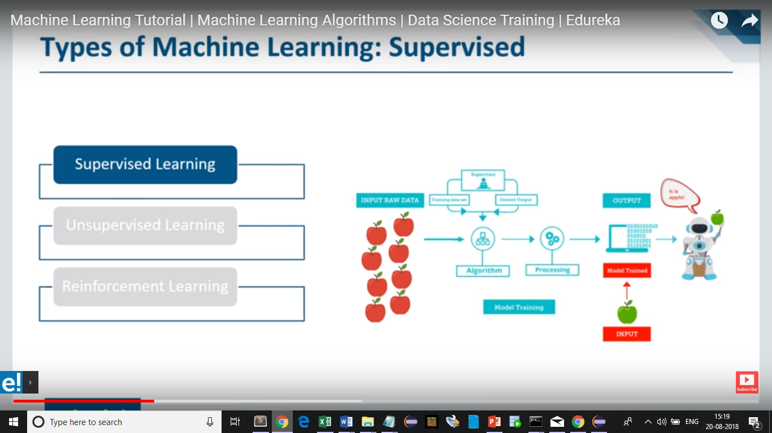
Types of machine learning

Slide 23
Types of machine learning

Slide 24
Types of machine learning
Supervised Learning
Supervised learning as the name indicates a presence of supervisor as teacher. Basically supervised learning is a learning in which we teach or train the machine using data which is well labeled that means some data is already tagged with correct answer. After that, machine is provided with new set of examples(data) so that supervised learning algorithm analyses the training data(set of training examples) and produces an correct outcome from labelled data.
For instance, suppose you are given an basket filled with different kinds of fruits. Now the first step is to train the machine with all different fruits one by one like this:
If shape of object is rounded and depression at top having color Red then it will be labelled as –Apple.
If shape of object is long curving cylinder having color Green-Yellow then it will be labelled as –Banana.
Now suppose after training the data, you have given a new separate fruit say Banana from basket and asked to identify it.
Supervised learning classified into two categories of algorithms:
Classification: A classification problem is when the output variable is a category, such as “Red” or “blue” or “disease” and “no disease”.
Regression: A regression problem is when the output variable is a real value, such as “dollars” or “weight”.

Slide 25
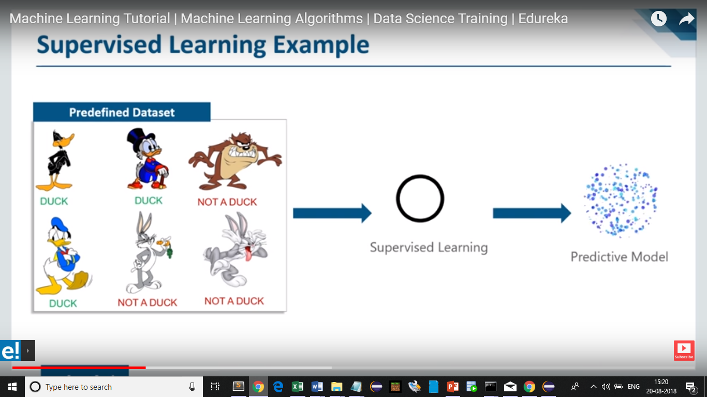
Types of machine learning

Slide 26
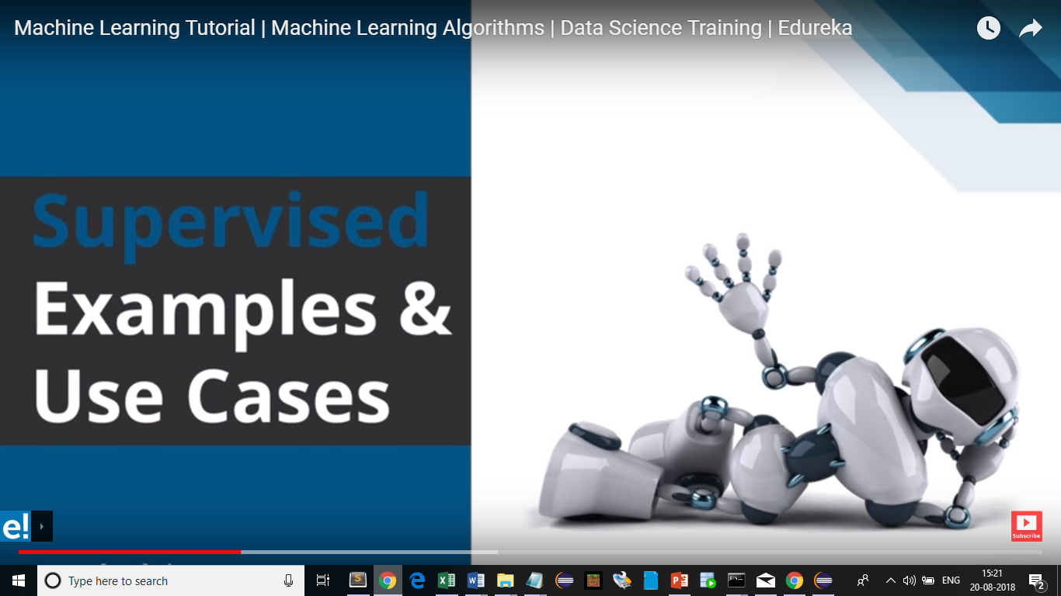
Types of machine learning

Slide 27
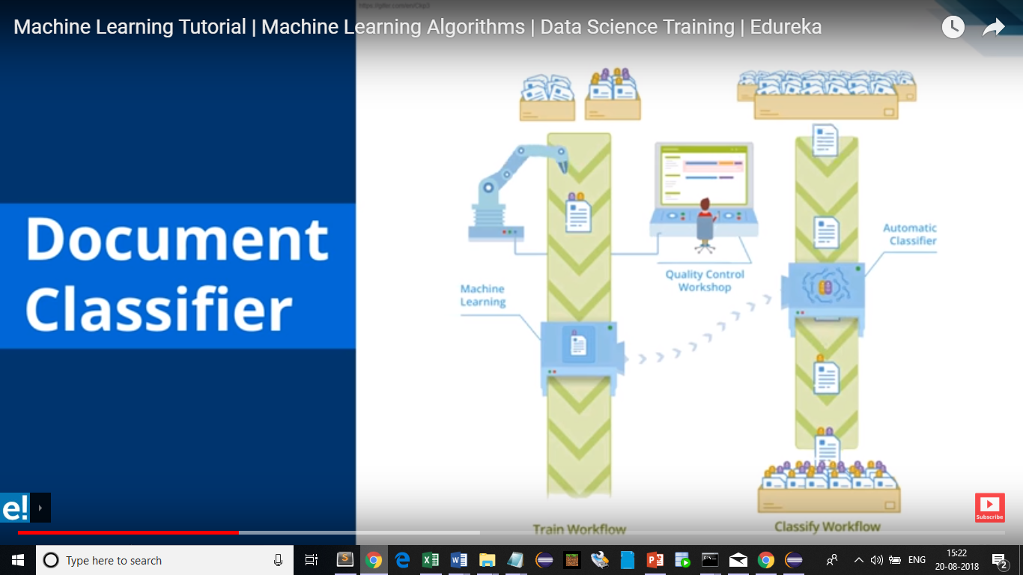
Types of machine learning

Slide 28
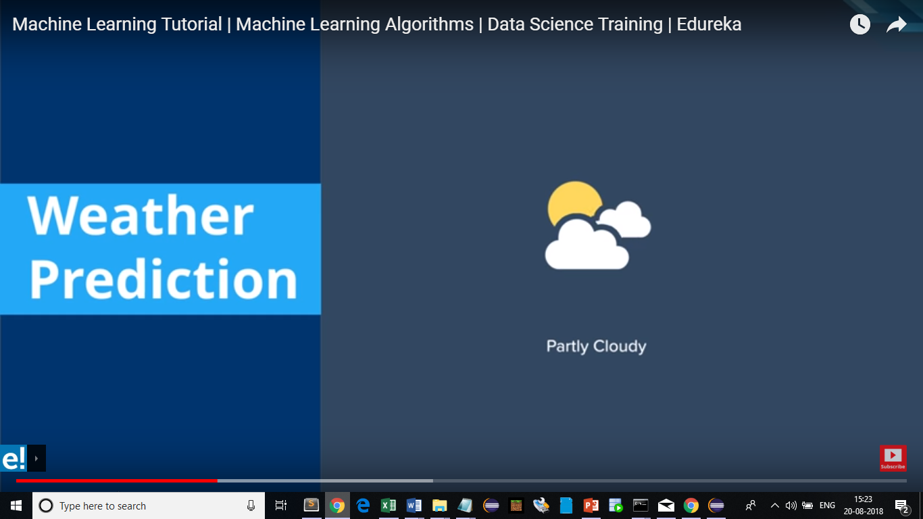
Types of machine learning

Slide 29
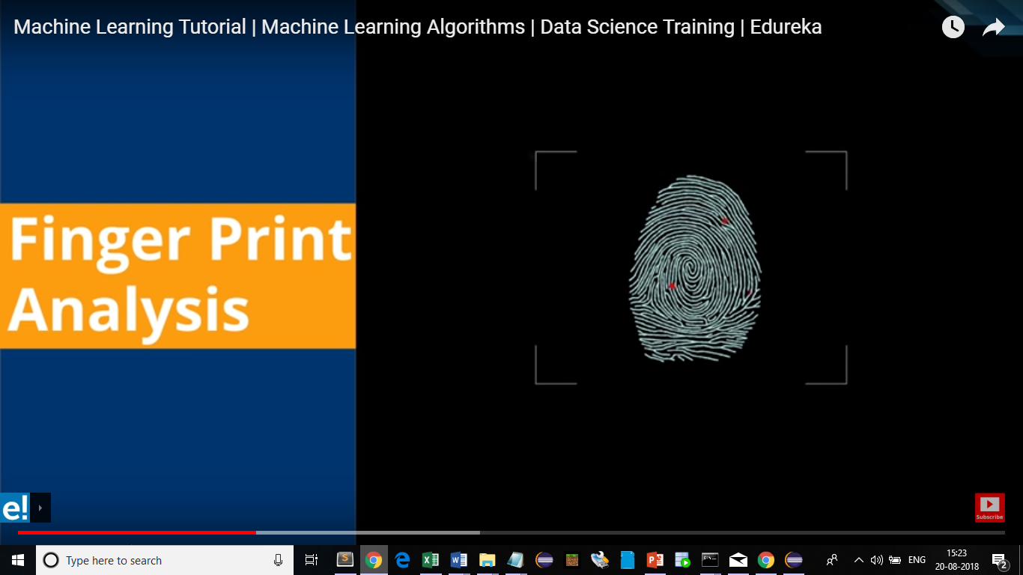
Types of machine learning

Slide 30
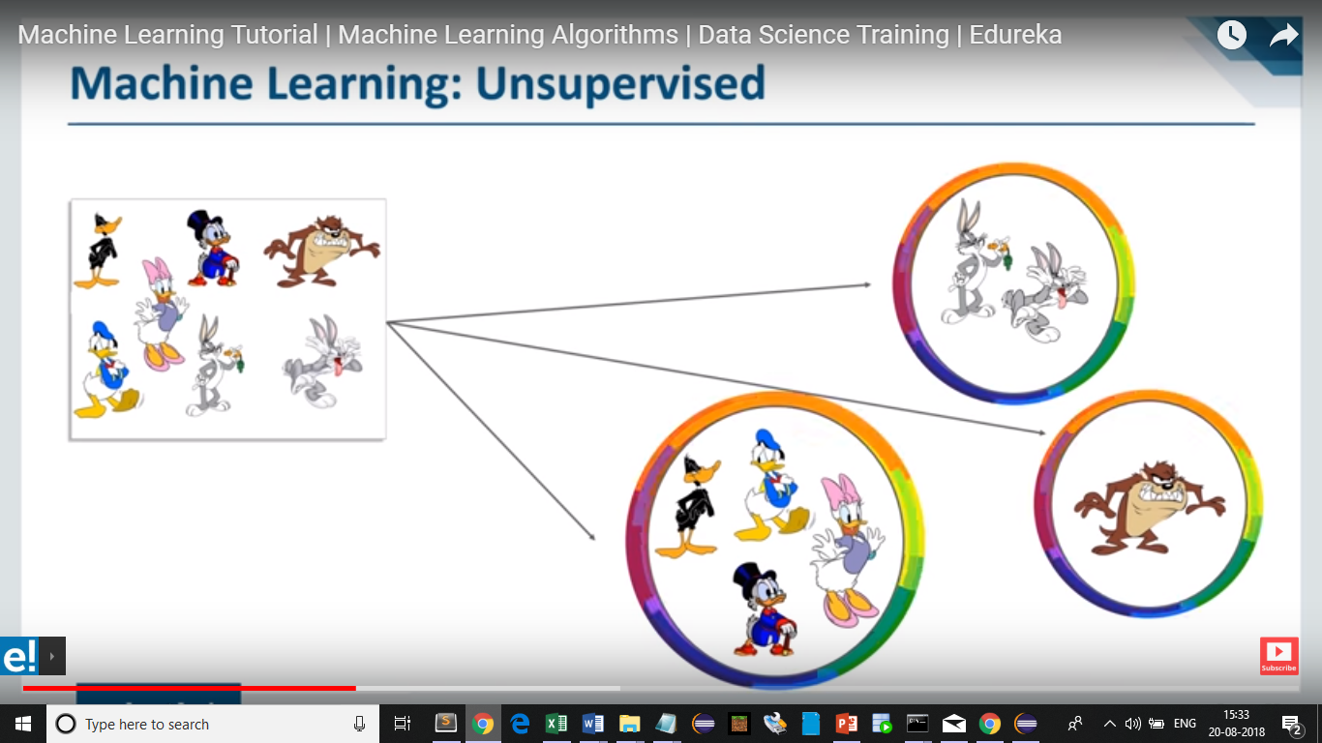
Types of machine learning

Slide 31
Types of machine learning
Unsupervised learning
Unsupervised learning is the training of machine using information that is neither classified nor labelled and allowing the algorithm to act on that information without guidance. Here the task of machine is to group unsorted information according to similarities, patterns and differences without any prior training of data.
Unlike supervised learning, no teacher is provided that means no training will be given to the machine. Therefore machine is restricted to find the hidden structure in unlabeled data by our-self. For instance, suppose it is given an image having both dogs and cats which have not seen ever.
Thus machine has no any idea about the features of dogs and cat so we can’t categorize it in dogs and cats. But it can categorize them according to their similarities, patterns and differences i.e., we can easily categorize the above picture into two parts. First first may contain all pics having dogs in it and second part may contain all pics having cats in it. Here you didn’t learn anything before, means no training data or examples.
Unsupervised learning classified into two categories of algorithms:
Clustering: A clustering problem is where you want to discover the inherent groupings in the data, such as grouping customers by purchasing behavior.
Association: An association rule learning problem is where you want to discover rules that describe large portions of your data, such as people that buy X also tend to buy Y.

Slide 32
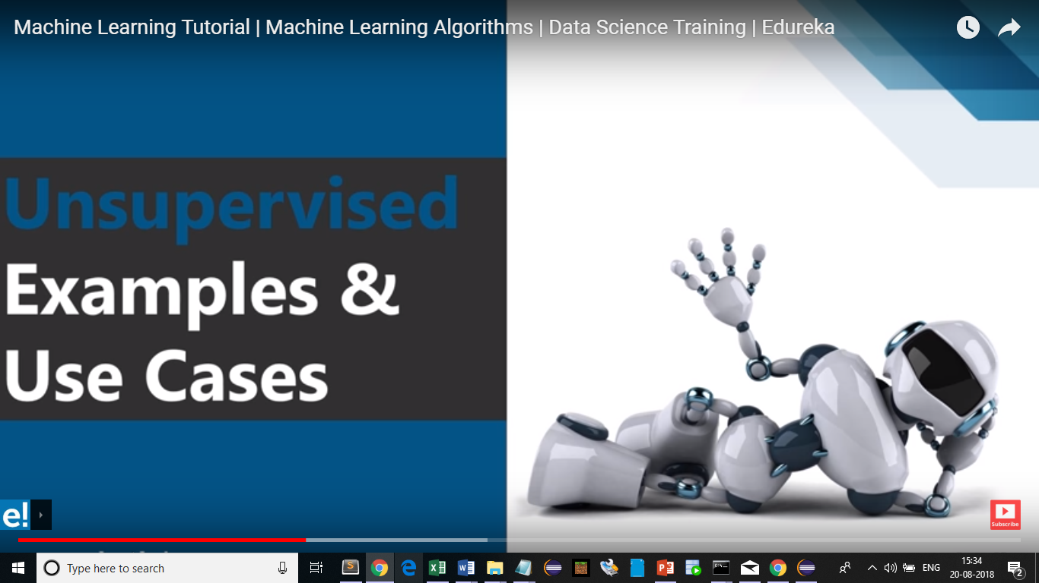
Types of machine learning

Slide 33
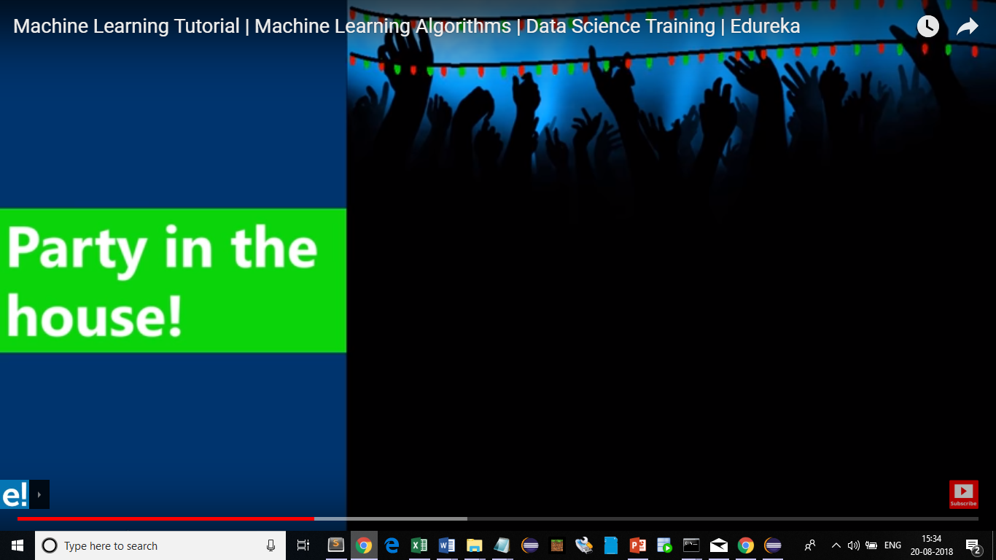
Types of machine learning

Slide 34
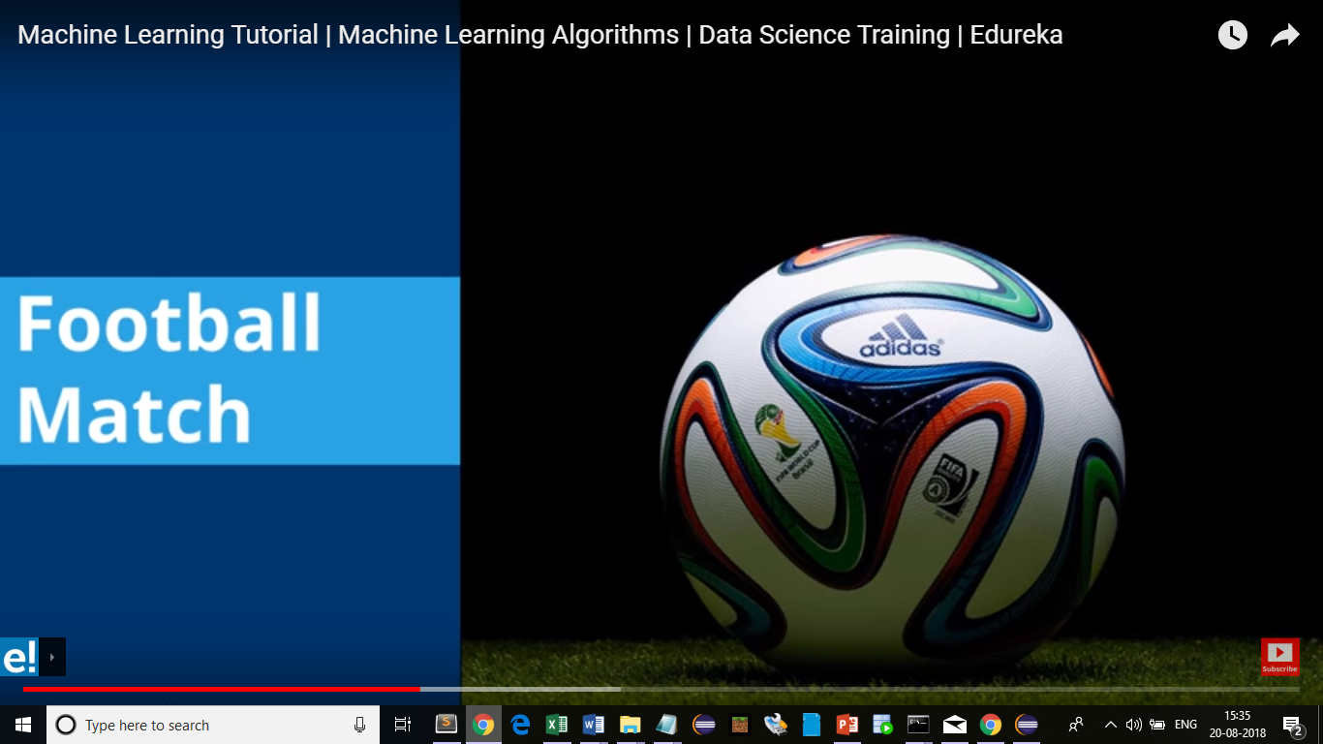
Types of machine learning

Slide 35

Types of machine learning

Slide 36
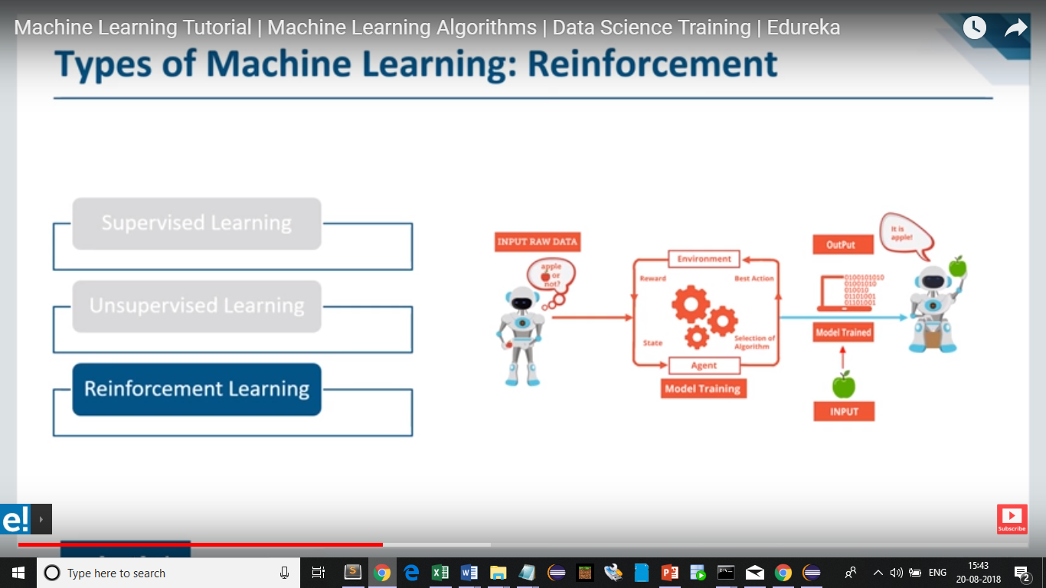
Types of machine learning

Slide 37
Types of machine learning
Reinforcement learning is an important type of Machine Learning where an agent learn how to behave in a environment by performing actions and seeing the results.
The idea behind Reinforcement Learning is that an agent will learn from the environment by interacting with it and receiving rewards for performing actions.
Learning from interaction with the environment comes from our natural experiences. Imagine you’re a child in a living room. You see a fireplace, and you approach it.
It’s warm, it’s positive, you feel good (Positive Reward +1). You understand that fire is a positive thing.
But then you try to touch the fire. Ouch! It burns your hand (Negative reward -1). You’ve just understood that fire is positive when you are a sufficient distance away, because it produces warmth. But get too close to it and you will be burned.
That’s how humans learn, through interaction. Reinforcement Learning is just a computational approach of learning from action.

Slide 38
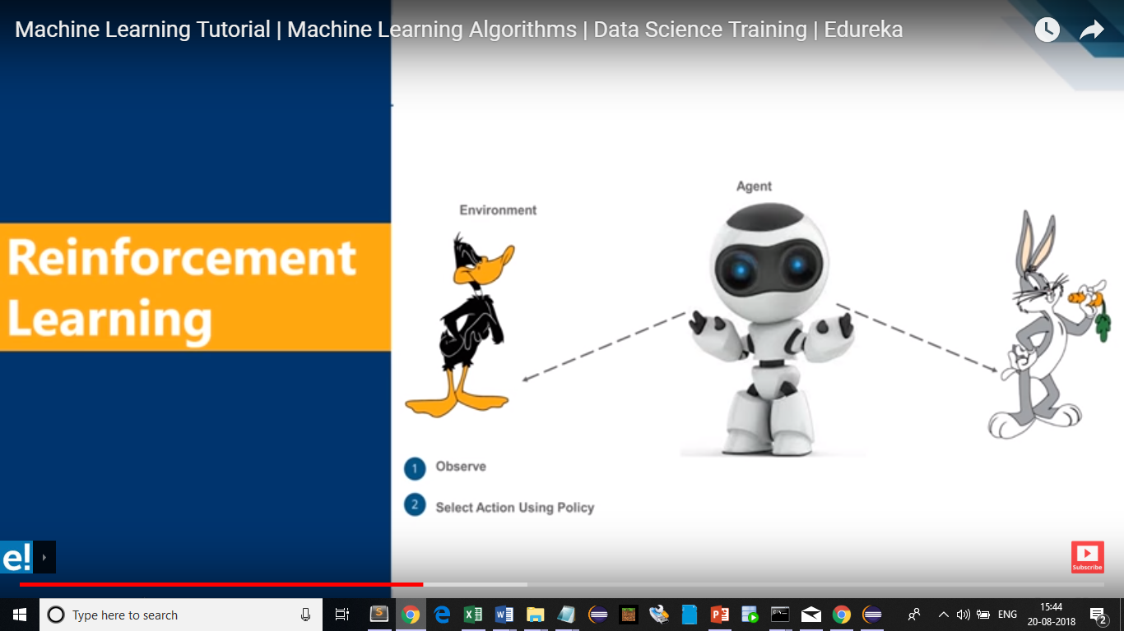
Types of machine learning

Slide 39
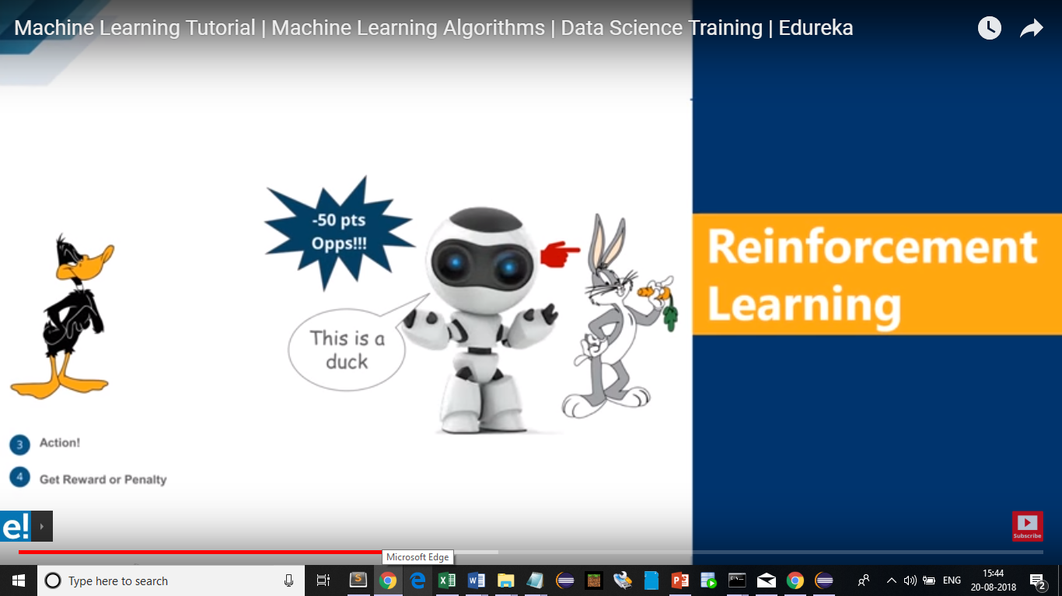
Types of machine learning

Slide 40
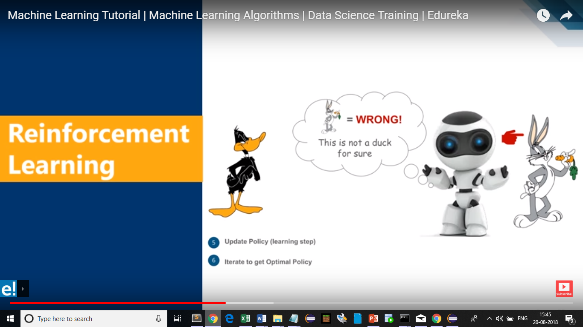
Types of machine learning

Slide 41
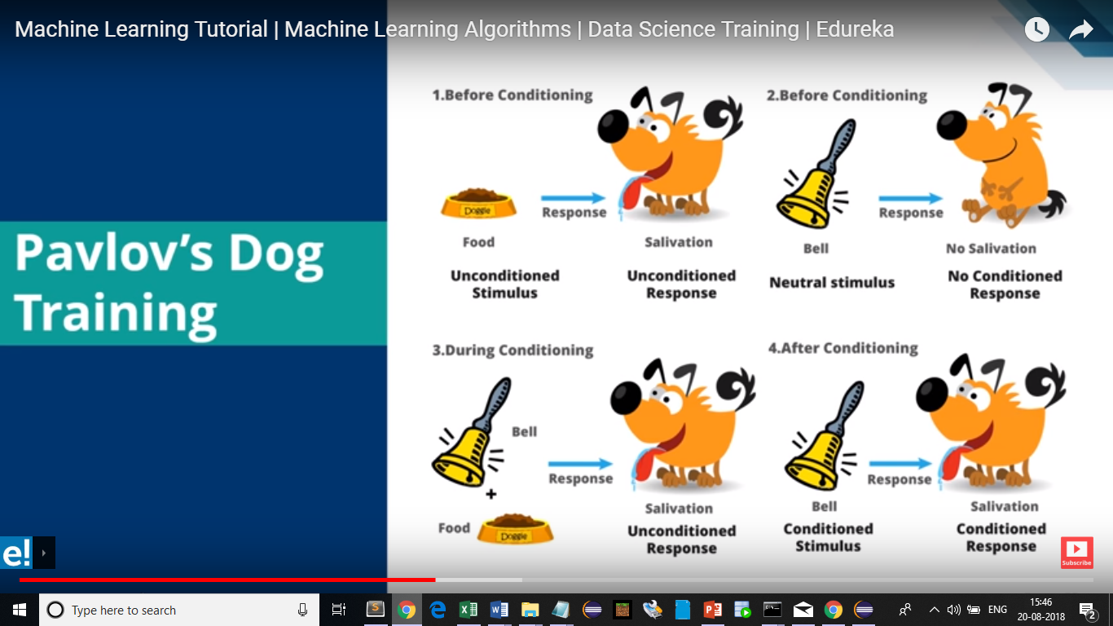
Types of machine learning

Slide 42
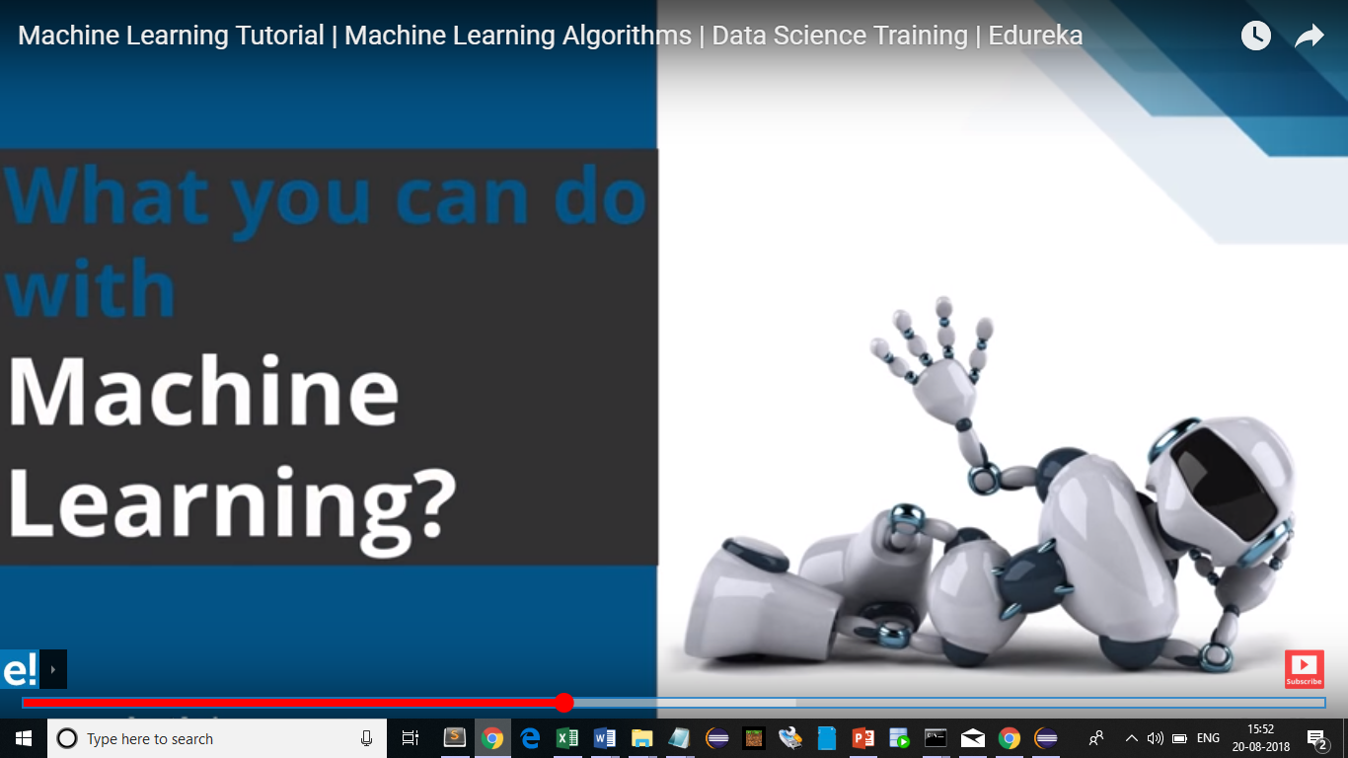
Usage of machine learning

Slide 43
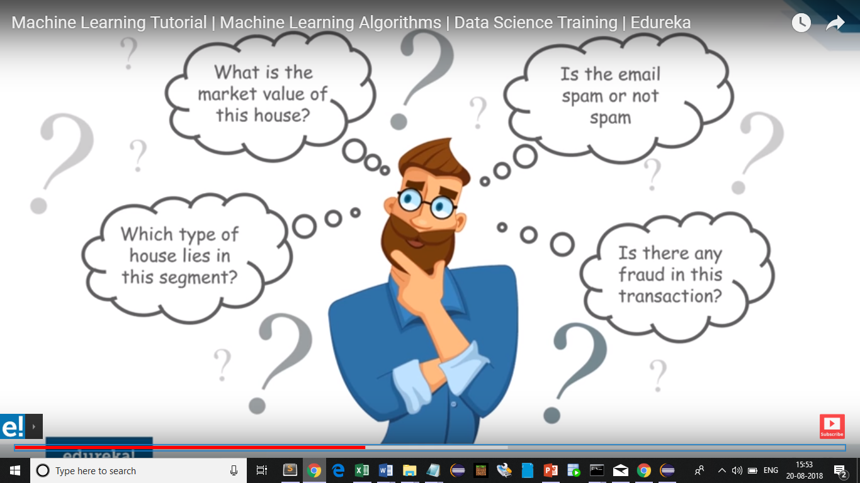
Usage of machine learning

Slide 44
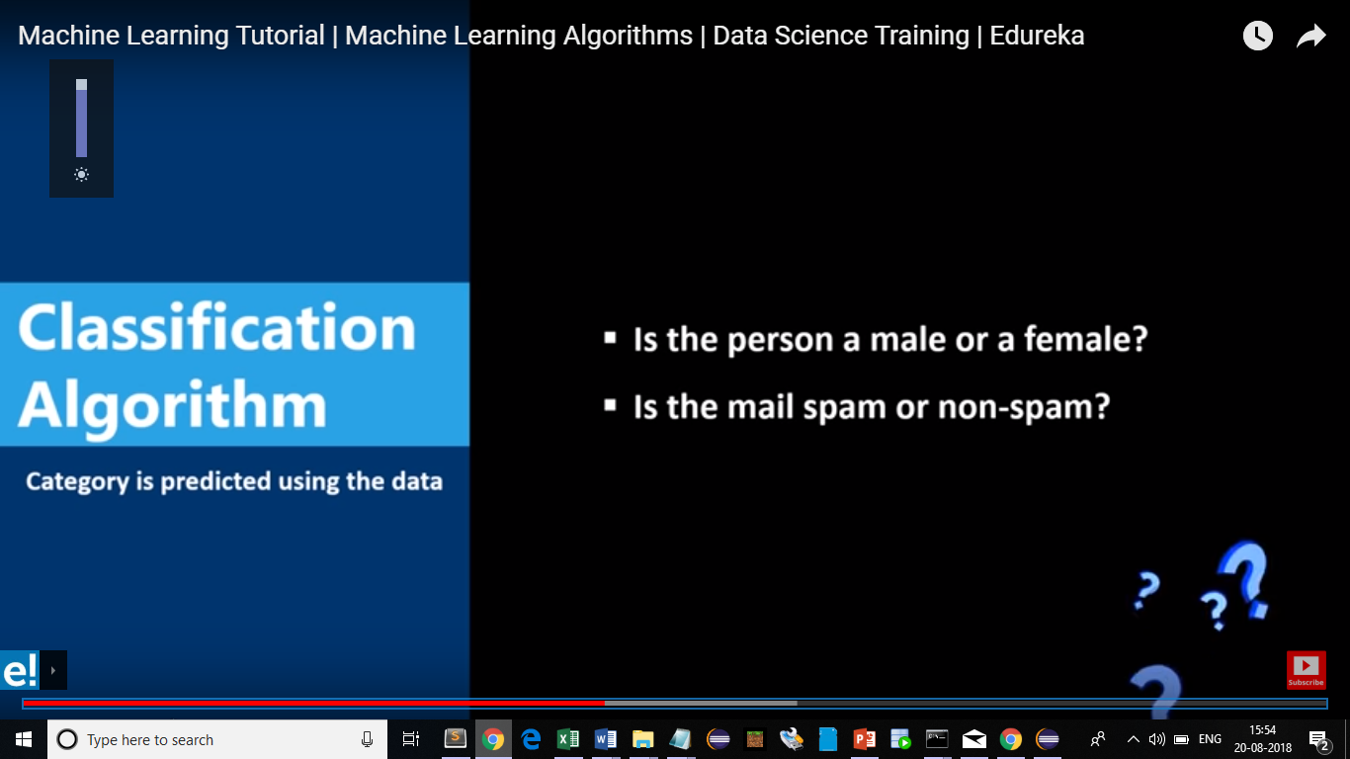
Types of Algorithm

Slide 45
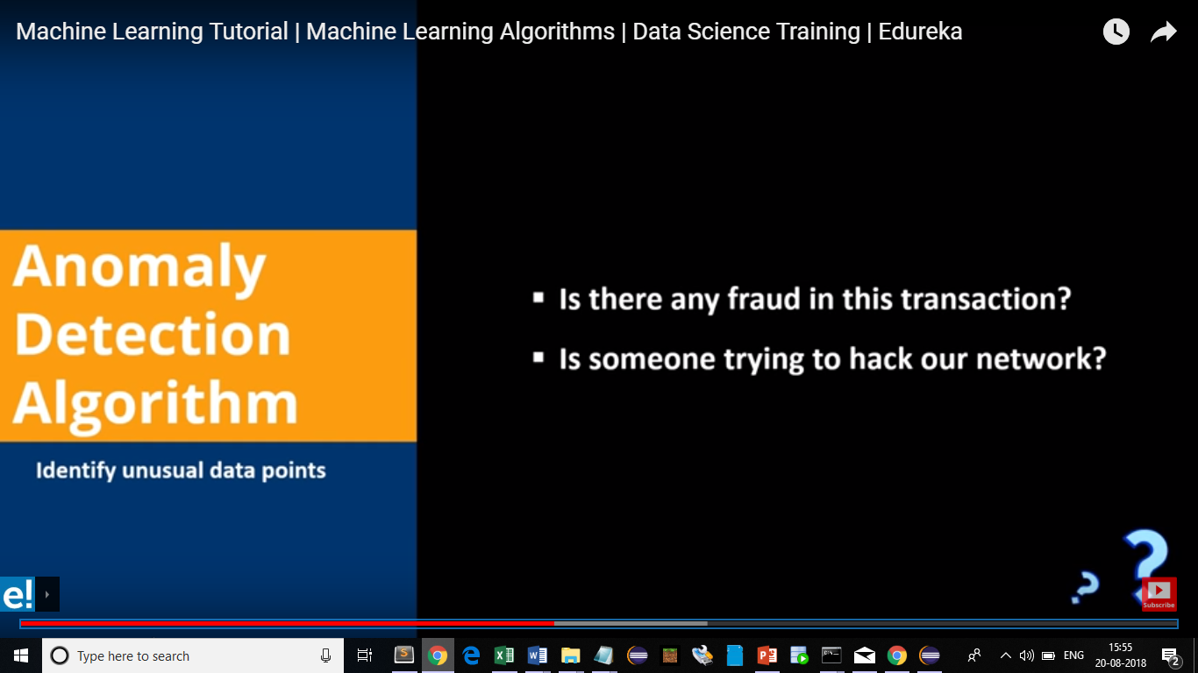
Types of Algorithm

Slide 46
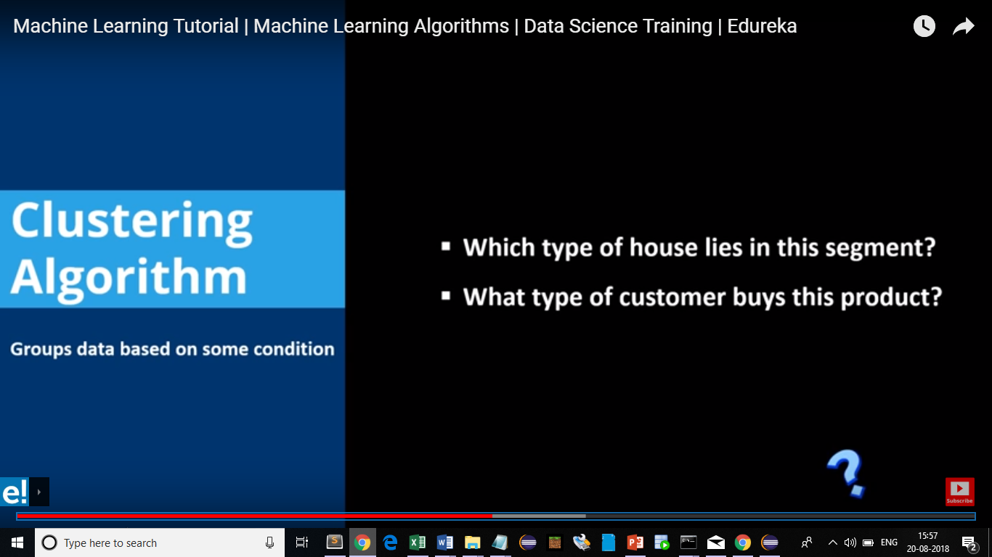
Types of Algorithm

Slide 47
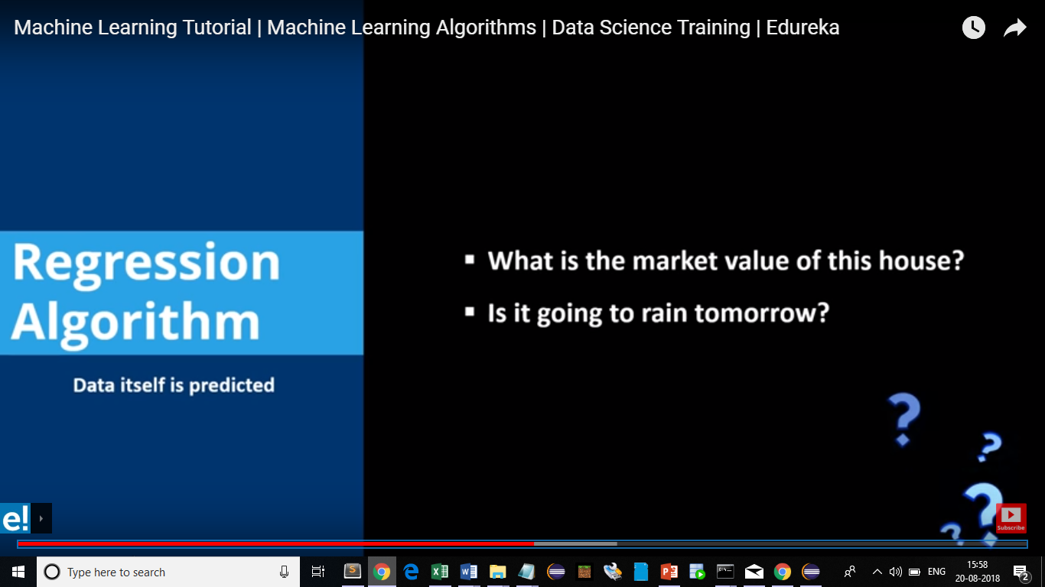
Types of Algorithm

Slide 48
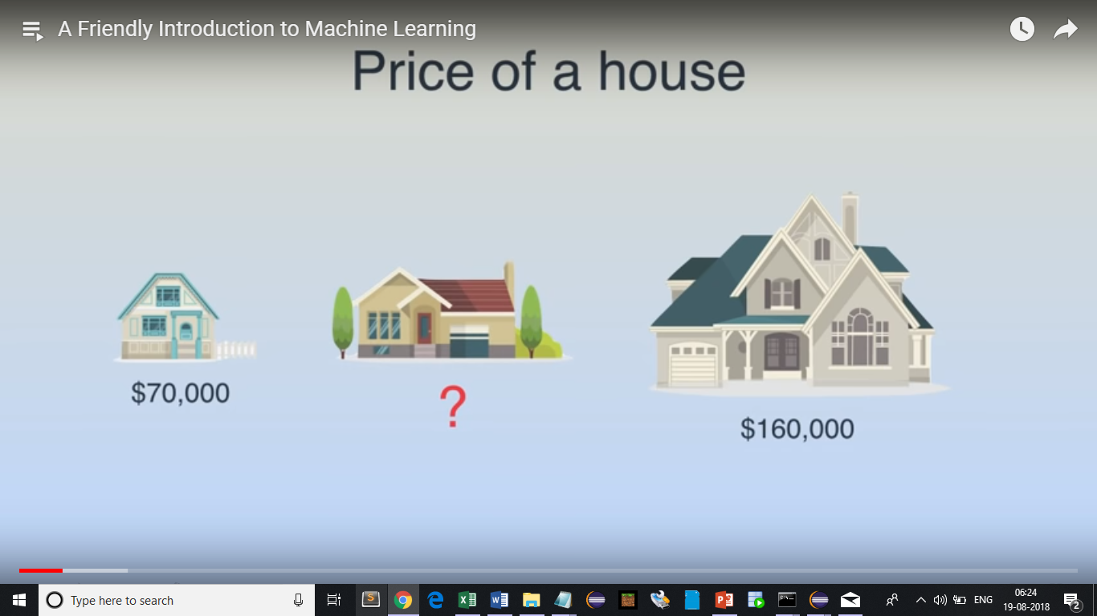
Predict price of a house

Slide 49
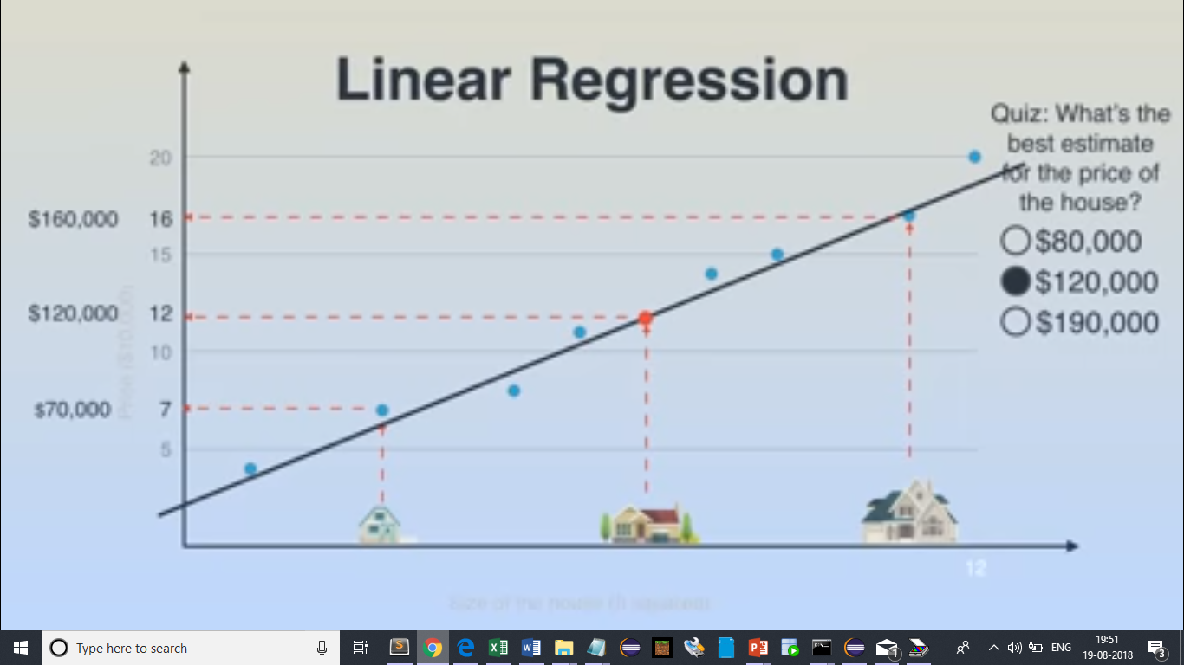
Predict price of a house

Slide 50
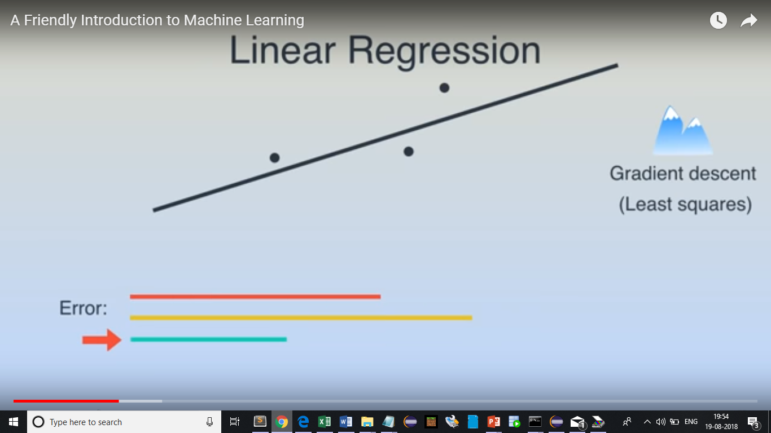
Linear Regression

Slide 51
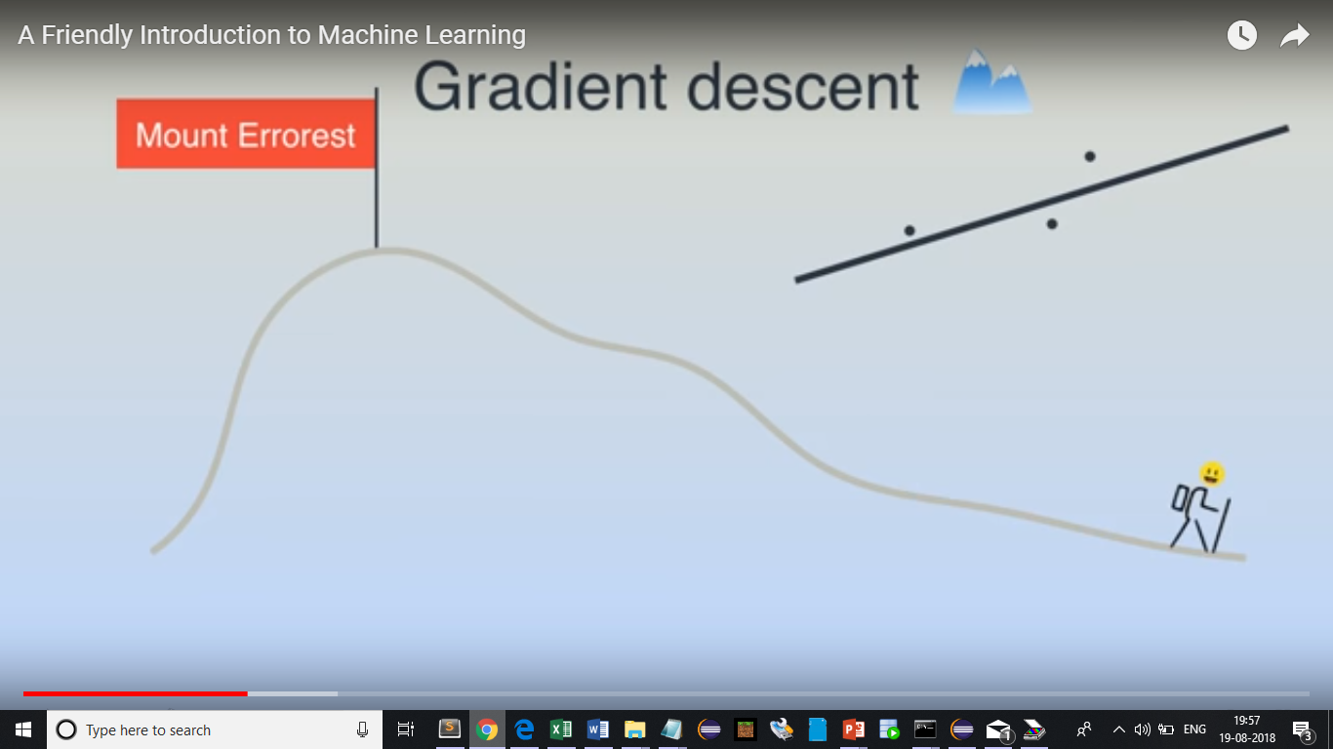
Gradient descent

Slide 52
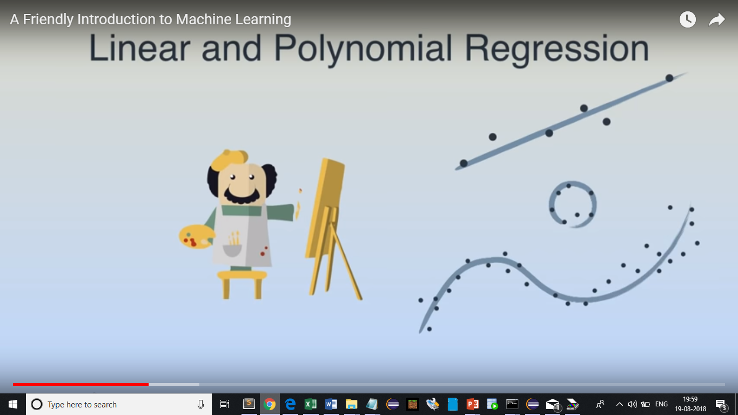
Gradient descent

Slide 53
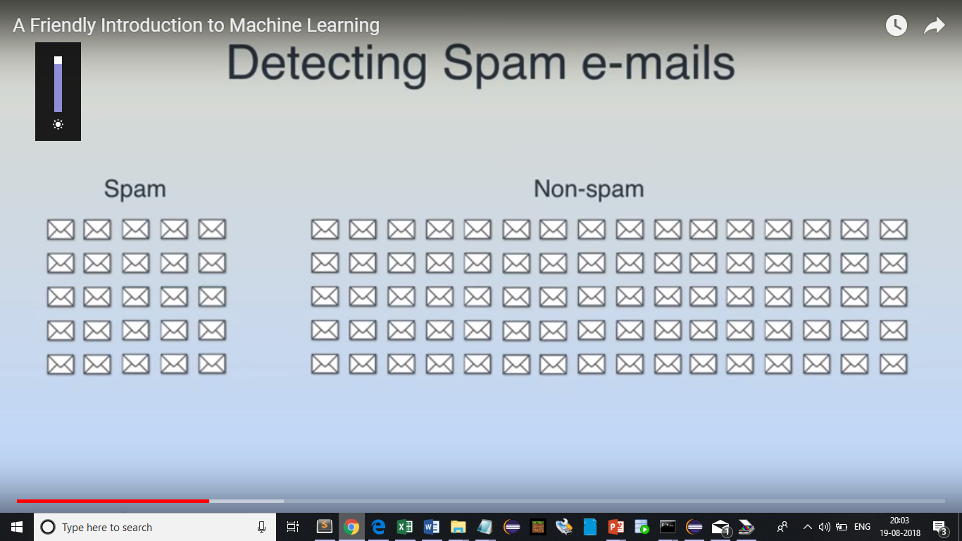
Detecting spam email

Slide 54
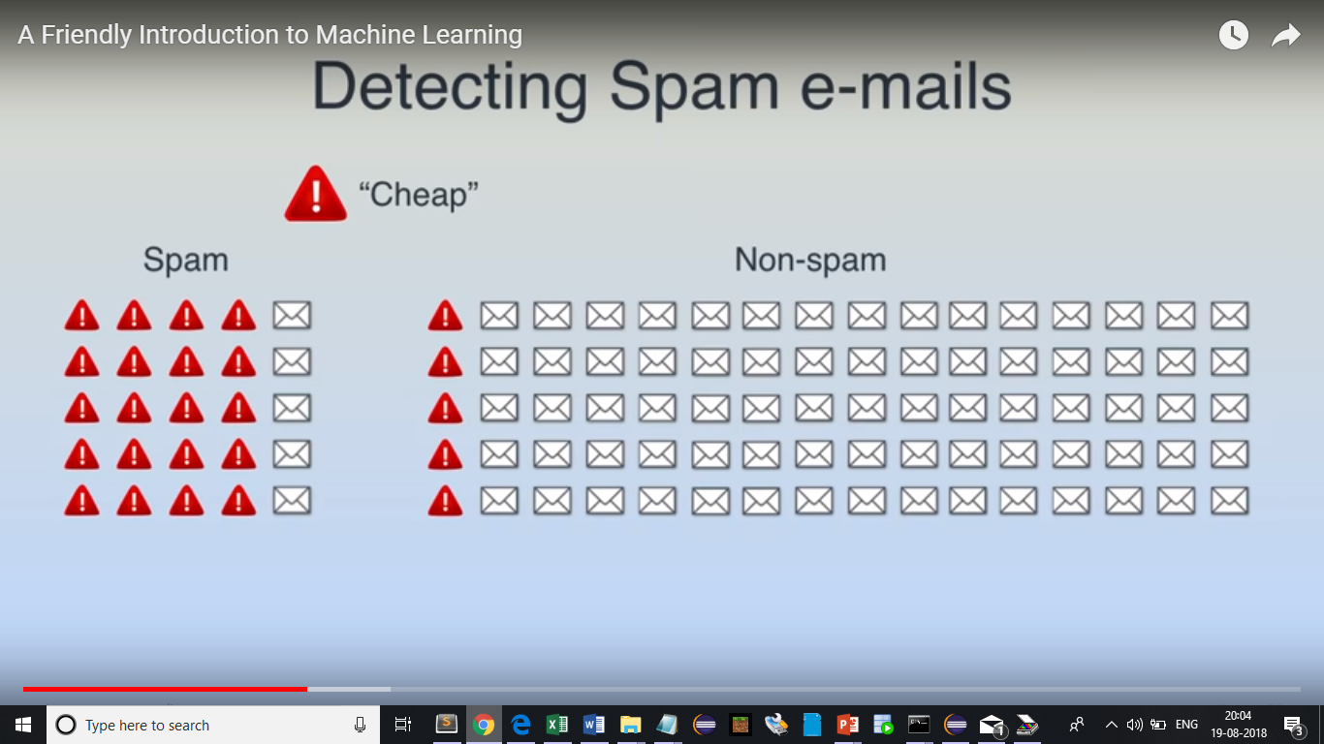
Detecting spam email

Slide 55
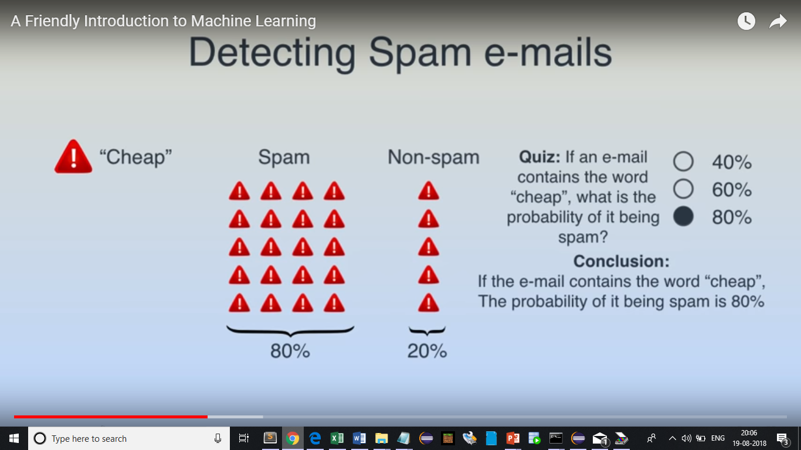
Detecting spam email

Slide 56
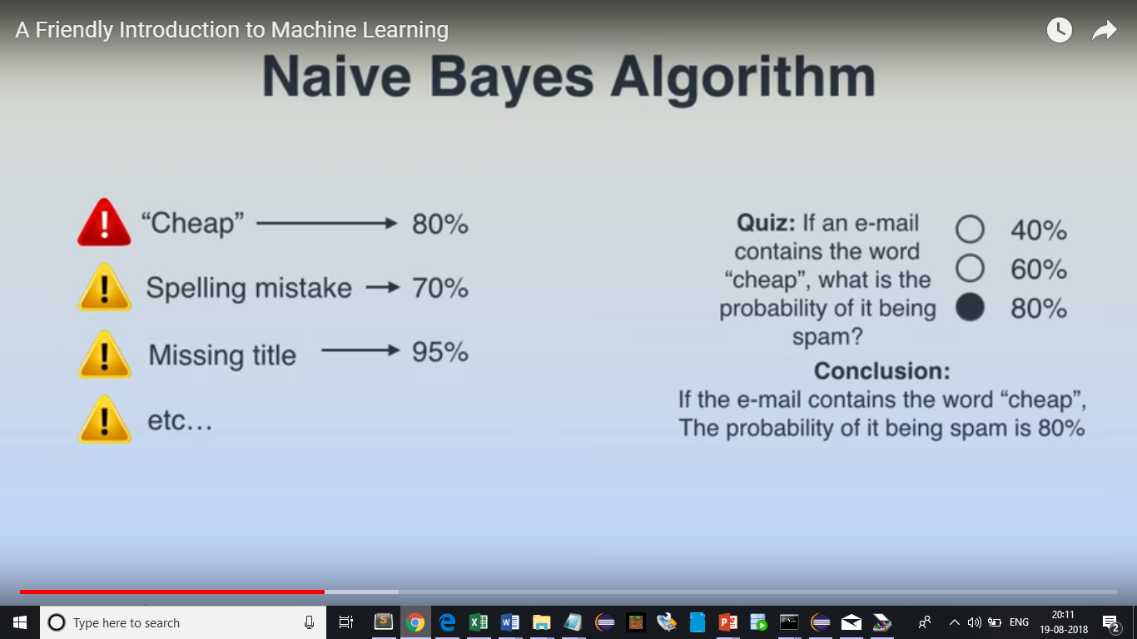
Detecting spam email

Slide 57
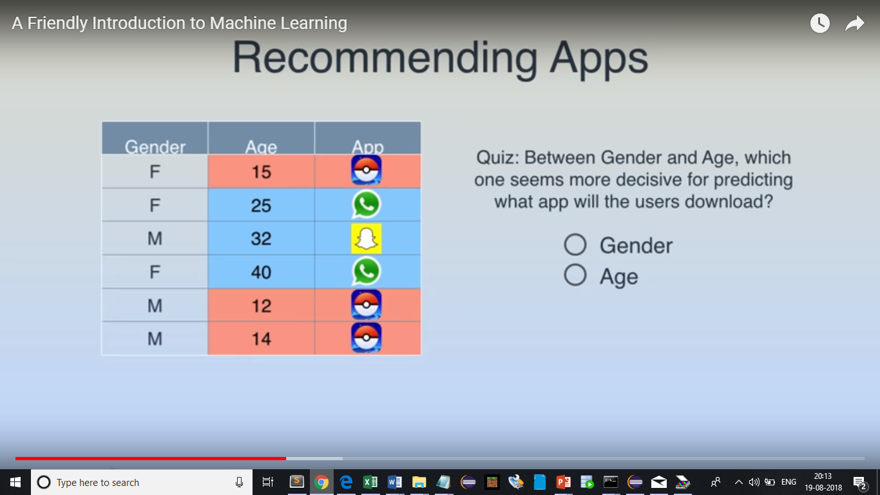
Recommending Apps

Slide 58
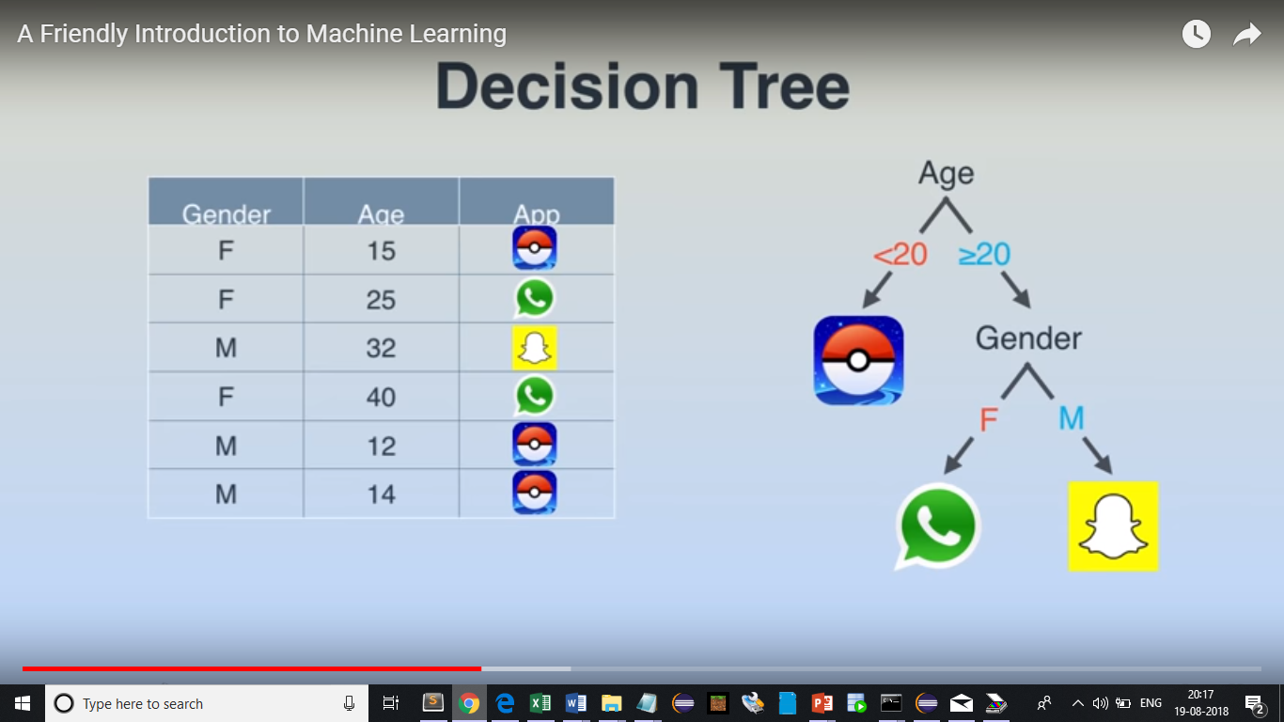
Recommending Apps

Slide 59
Linear Regression
Use case
Year of Experience vs Salary
Find out the correlation between Salary and experience

Slide 60
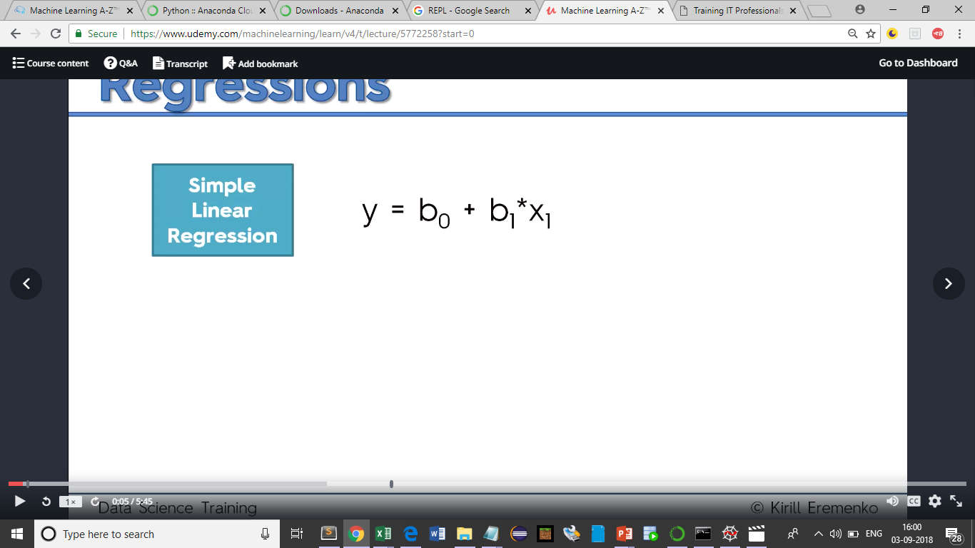
Linear Regression

Slide 61

Linear Regression

Slide 62
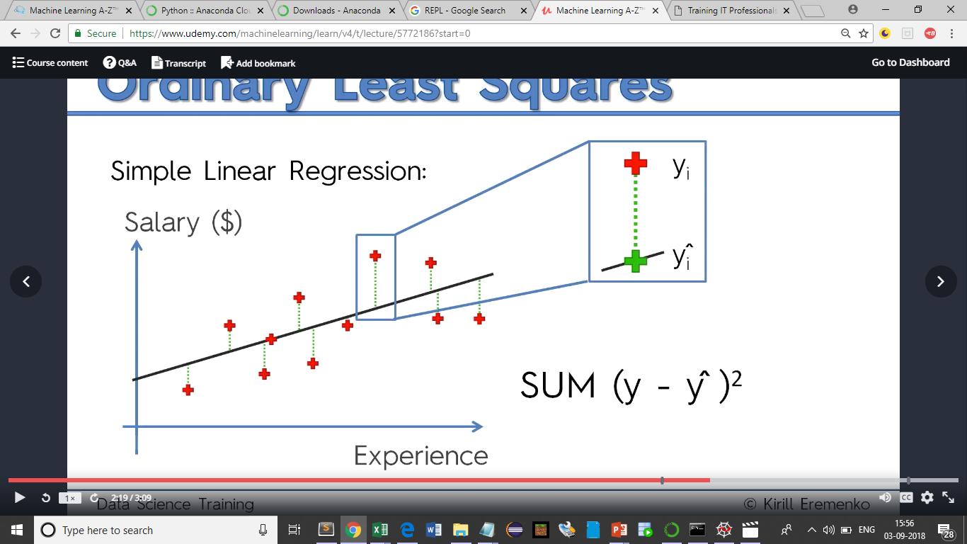
Linear Regression

Slide 63
Thank You

Slide 64
Machine Learning
Introduction
Machine Learning is the competency of the software to perform a single or series of tasks intelligently without being programmed for these activities.
What is the need for machine learning.
There are some situations you cannot not program to get the output. For example Google Search engine.

Slide 65
Machine Learning
How machine learning works
Machine Learning is a technique which works intelligently by using some complex algorithms and set of predefined rules.IT uses the past data to read the patterns and then based on the analysis it generates the relevant data or performs the intended task abiding the defined rules and algorithms.
For ex: Search engines uses this machine learning techniques to display the related contents. It intelligently reads the vast data on the web,indexes,ranks based on the defined rules and algorithms.

Slide 66
Machine Learning
Machine learning products
Moley (Robotic kitchen)– http://www.moley.com/
Deepblue (Chess playing super computer) - https://en.wikipedia.org/wiki/Deep_Blue_versus_Garry_Kasparov
IBM Watson – Watson is a question-answering computer system capable of answering questions posed in natural language,[2] developed in IBM's DeepQA project by a research team led by principal investigator David Ferrucci.
https://www.youtube.com/watch?v=_Xcmh1LQB9I

Slide 67
Machine Learning - Examples
Google and other search engines
Diagnosis of deadly diseases
Face recognition and tagging feature
Detection of spam emails
Display of related advertisements
Speech recognition/translation …. Much more…

Slide 68
Machine Learning – Area of recognition
Statistics
Brain models
Adoptive Control theory
Psychology
Artificial intelligence
Evolutionary models

Slide 69
Machine Learning – Formal definition
Definition 1 – A field of study that gives the computers the ability to learn without being explicitly programmed (Arthus Samuel)
Definition 2 – A computer program is said to learn from experiences E with respect to some class of tasks T and performance P, if its performance at tasks in T,as measured by P,improves with experience E (Tom Mitchell)
Example –
Checkers learning problem
https://www.youtube.com/watch?v=ScKIdStgAfU
Handwriting recognition learning problem
A robot driving learning problem

Slide 70
Machine Learning – Examples of machine learning
Checker Learning Problem
Task T : Playing Checkers
Performance Measure P : Percent of games won against opponents
Training Experience E : Playing practical games against itself
https://cedar.buffalo.edu/~srihari/CSE574/Chap1/Machine-Learning-Intro-old.pdf
Handwriting recognition learning Problem
Task T : Recognizing and classifying handwritten words within images
Performance Measure P : Percent of words correctly classified
Training Experience E : a database of handwritten words with given clasifications

Slide 71
Machine Learning – Examples of machine learning
A robot driving learning problem
Task T : Driving of public four lane using vision sensors
Performance Measure P : Average distance travelled before an error(as judged by human overseer)
Training Experience E : A sequence of images and steering commands recorded while observing a human driver
https://www.youtube.com/watch?v=aaOB-ErYq6Y
https://www.youtube.com/watch?v=xMH8dk9b3yA
https://www.youtube.com/watch?v=tiwVMrTLUWg

Slide 72
Machine Learning – Classification
https://towardsdatascience.com/machine-learning-101-supervised-unsupervised-reinforcement-beyond-f18e722069bc
https://www.quora.com/What-is-the-difference-between-regression-classification-and-clustering-in-machine-learning

Slide 73
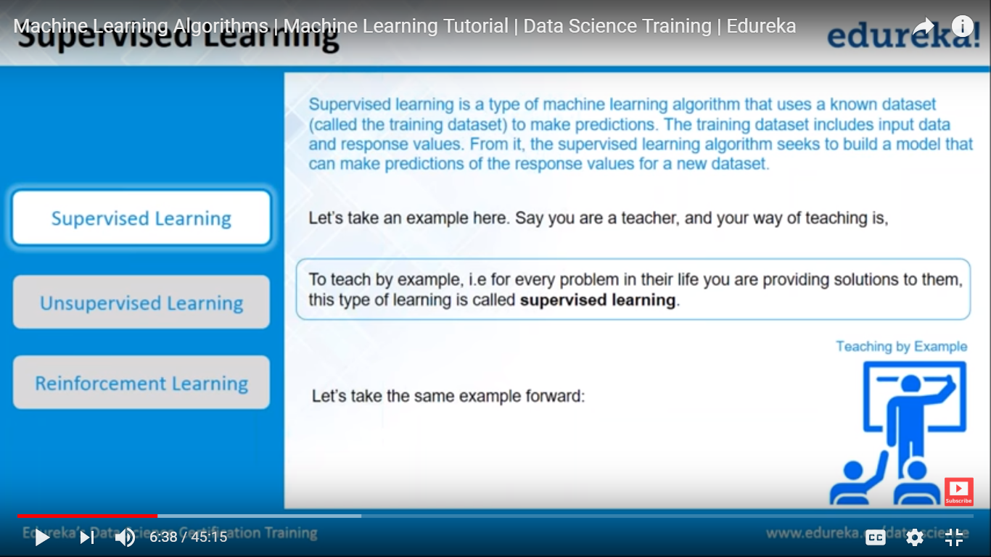
Classification of machine learning

Slide 74
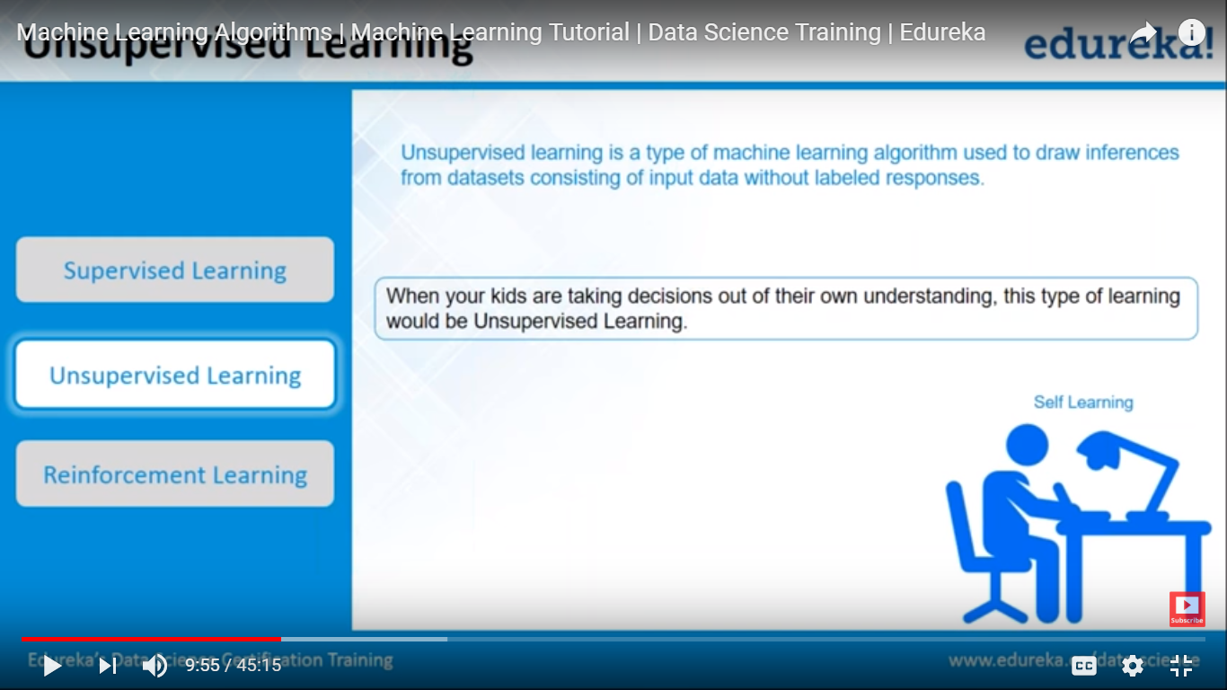
Classification of machine learning

Slide 75
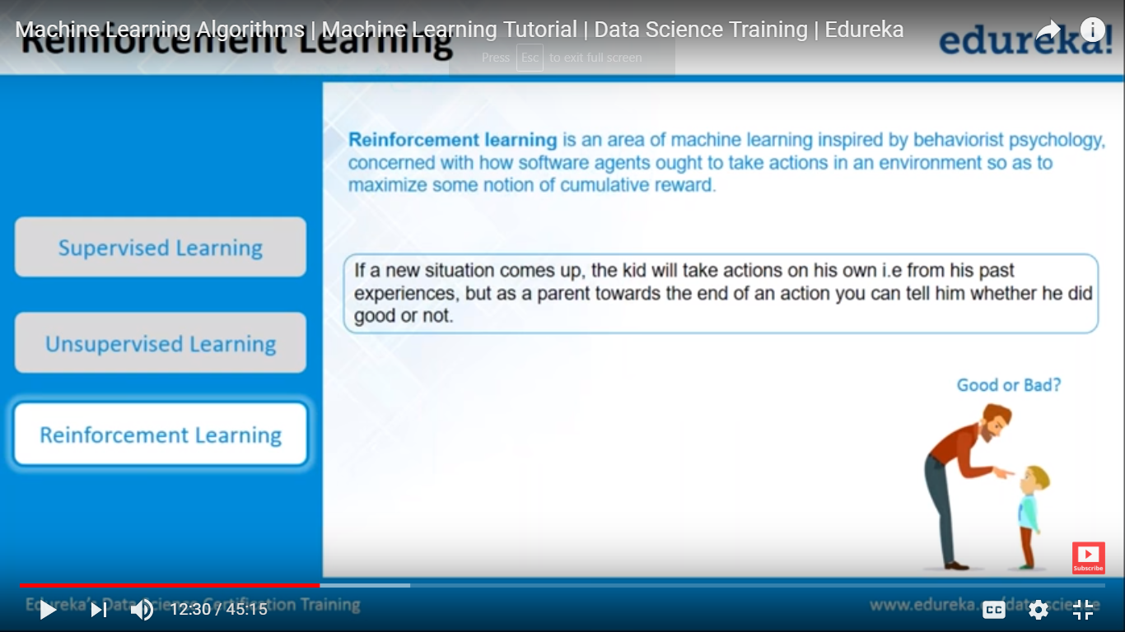
Classification of machine learning

Slide 76
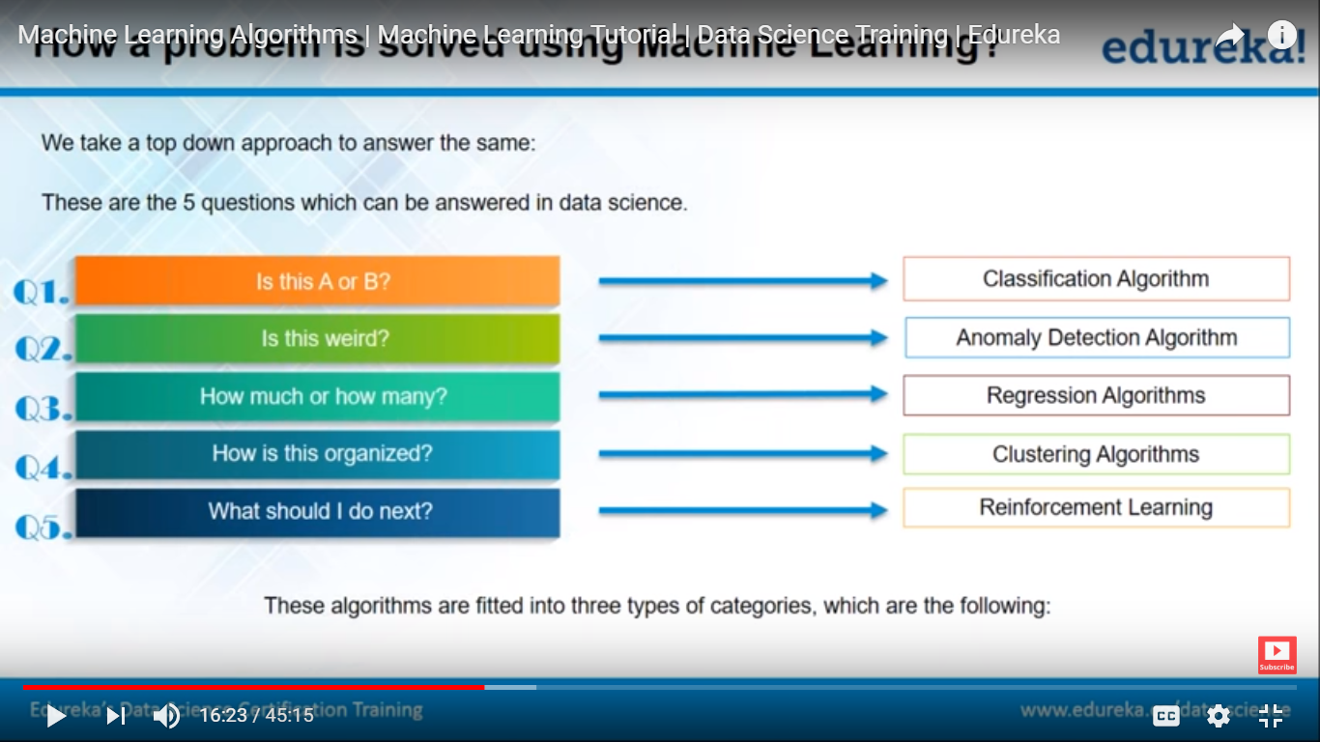
How to solve a problem

Slide 77

How to solve a problem

Slide 78

How to solve a problem

Slide 79

How to solve a problem

Slide 80

How to solve a problem

Slide 81

How to solve a problem

Slide 82

Linear Regression
y = ax + b
Linear regression is a way to model the relationship between two variables. You might also recognize the equation as the slope formula. The equation has the form Y=a+bX, where Y is the dependent variable (that’s the variable that goes on the Y axis), X is the independent variable (i.e. it is plotted on the X axis), b is the slope of the line and a is the y-intercept.

Slide 83

Linear Regression - Correlation coefficients
Correlation coefficients are used in statistics to measure how strong a relationship is between two variables. There are several types of correlation coefficient: Pearson’s correlation (also called Pearson’s R) is a correlation coefficient commonly used in linear regression. If you’re starting out in statistics, you’ll probably learn about Pearson’s R first. In fact, when anyone refers to the correlation coefficient, they are usually talking about Pearson’s.
http://www.statisticshowto.com/probability-and-statistics/correlation-coefficient-formula/

Slide 84
Degree of polynomial - Linear
Degree 1 - Linear Polynomials - After combining the degrees of terms if the highest degree is 1 it is called Linear Polynomials
Examples of Linear Polynomials are
2x : This can also be written as 2x1, as the highest degree of this term is 1 it is called Linear Polynomial
2x + 2 :
This can also be written as 2x1 + 2
Term 2x has the degree 1 .
Term 2 has the degree 0.
As the highest degree we can get is 1 it is called Linear Polynomial
2x + 2y + 2 :
This can also be written as 2x1 + 2y1 + 2
Term 2x has the degree 1
Term 2y also has the degree 1
Term 2 has the degree 0
As the highest degree we can get is 1 it is called Linear Polynomial

Slide 85
Degree of polynomial - Quadratic
Degree 2 - Quadratic Polynomials - After combining the degrees of terms if the highest degree of any term is 2 it is called Quadratic Polynomials
Examples of Quadratic Polynomials are `
After combining the degrees of term 2xy the sum total of degree is 2.
Term 2y has the degree 1
As the highest degree we can get is 2 it is called Quadratic Polynomial
2xy + 2y - 1 -
This can also be written as 2x1y1 + 2y1 - 1
After combining the degrees of term 2xy, the sum total of degree is 2.
Term 2y has the degree 1
Term 1 has the degree 0.
As the highest degree we can get is 2 it is called Quadratic Polynomial

Slide 86
Degree of polynomial - Cubic
Degree 3 - Cubic Polynomials - After combining the degrees of terms if the highest degree of any term is 3 it is called Cubic Polynomials Examples of Cubic Polynomials are 2x3 : This is a single term having highest degree of 3 and is therefore called Cubic Polynomial.
2x3 + 2y2 :
Term 2x3 has the degree 3
Term 2y2 has the degree 2
As the highest degree we can get is 3 it is called Cubic Polynomial
2x3 + 2y2 + 2 :
Term 2x3 has the degree 3
Term 2y2 has the degree 2.
Term 2 has the degree 0
As the highest degree we can get is 3 it is called Cubic Polynomial
2x2z + 2y :
This can also be written as 2x2z1 + 2y1
After combining the degrees of term 2x2z, the sum total of degree is 3,
Term 2y has degree 1
As the highest degree we can get is 3 it is called Cubic Polynomial
2xyz + 2y + 2 : After combining the degrees of term 2xyz, the sum total of degree is 3, as highest degree of term is 3 it is called Cubic Polynomial
2x2 y + 2y + 2 :
This can also be written as 2x2 y1 + 2y1 + 2
After combining the degrees of term 2x2 y, the sum total of degree is 3
Term 2y has the degree 1
Term 2 has the degree 0
As the highest degree we can get is 3 it is called Cubic Polynomial

Slide 87
Supervised learning algorithms
Regression
Simple Linear Regression
Multiple Linear Regression
Polynomial Regression
Support Vector Regression
Decision Tree Regression
Random forest Regression

Slide 88

Supervised learning algorithms
Multiple Linear Regression

Slide 89

Supervised learning algorithms

Slide 90

Supervised learning algorithms – Multiple Linear

Slide 91

Supervised learning algorithms – Multiple Linear

Slide 92

Supervised learning algorithms – Multiple Linear

Slide 93

Supervised learning algorithms – Multiple Linear

Slide 94

Supervised learning algorithms – Multiple Linear

Slide 95

Supervised learning algorithms – Multiple Linear

Slide 96

Supervised learning algorithms – Multiple Linear

Slide 97

Supervised learning algorithms – Multiple Linear

Slide 98

Supervised learning algorithms – Multiple Linear

Slide 99

Supervised learning algorithms – Multiple Linear

Slide 100

Supervised learning algorithms – Multiple Linear

Slide 101

Supervised learning algorithms – Multiple Linear

Slide 102

Supervised learning algorithms – Polynomial Linear Regression

Slide 103

Supervised learning algorithms – Polynomial Linear Regression

Slide 104

Un-Supervised learning algorithms – Logistic Regression

Slide 105

Un-Supervised learning algorithms – Logistic Regression

Slide 106

Un-Supervised learning algorithms – Logistic Regression

Slide 107

Un-Supervised learning algorithms – Logistic Regression

Slide 108

Un-Supervised learning algorithms – K Nearest Neighbour Algorithm

Slide 109

Un-Supervised learning algorithms – K Nearest Neighbour Algorithm

Slide 110

Un-Supervised learning algorithms – K Nearest Neighbour Algorithm

Slide 111

K Nearest Neighbour Algorithm

Slide 112

KNN

Slide 113

Selection of algorithm

Slide 114

Support Vector Machine

Slide 115

Support Vector Machine

Slide 116

Support Vector Machine

Slide 117

Support Vector Machine

Slide 118
Support Vector Machine

Slide 119

Support Vector Machine

Slide 120

Support Vector Machine

Slide 121

Decision Tree (Classification and Regression Tree)

Slide 122

Decision Tree

Slide 123

Decision Tree

Slide 124

Decision Tree

Slide 125

Random Forest classification Applying multiple algorithm

Slide 126

Random Forest classification

Slide 127
Random Forest classification

Slide 128

Random Forest classification-Microsoft Kinect motion - https://www.youtube.com/watch?v=pzfpXAbQ61U

Slide 129

K-Means Clustering

Slide 130

K-Means Clustering

Slide 131

K-Means Clustering

Slide 132

K-Means Clustering

Slide 133

K-Means Clustering

Slide 134

K-Means Clustering

Slide 135

K-Means Clustering

Slide 136

K-Means Clustering

Slide 137

K-Means Clustering

Slide 138

K-Means Clustering

